Slide 1
HOW FACULTY USE THE FASB CODIFICATION AND COSO FRAMEWORK IN CLASS
Amy Igou and Veronica Paz

Slide 2
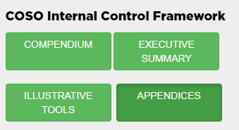
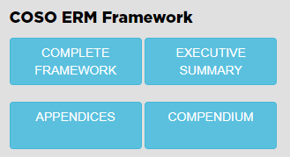
COSO Tools Available
COSO Internal Control Framework
COSO ERM Framework

Slide 3
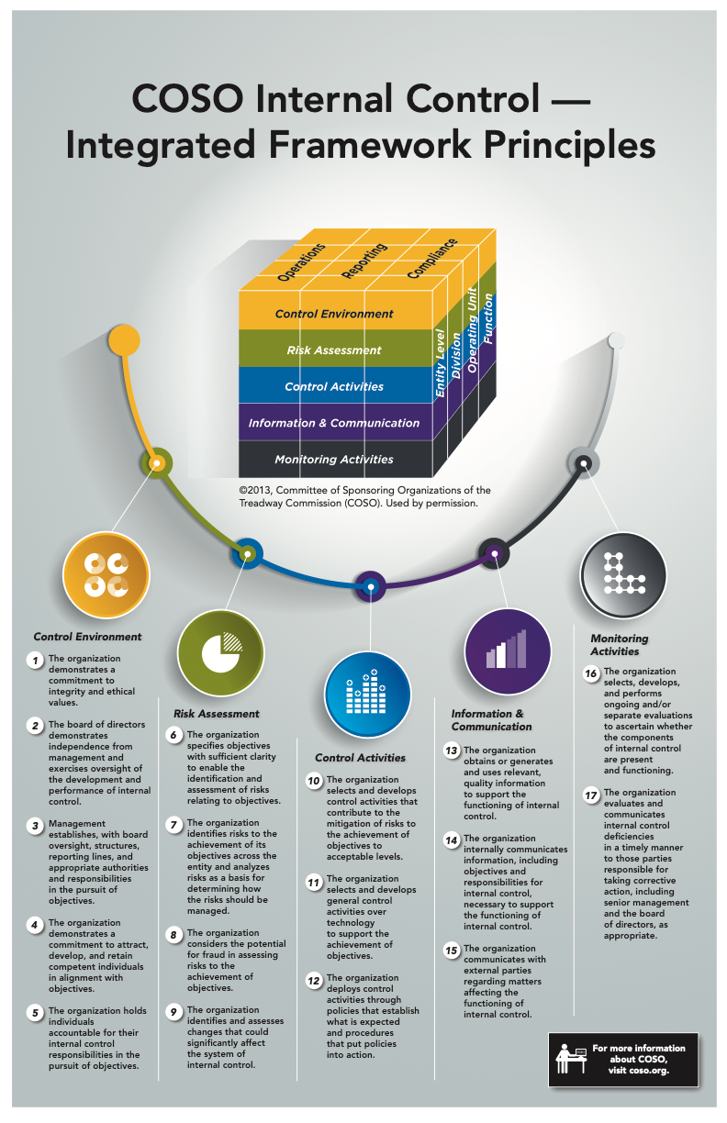

Slide 4
Research Project
Started with as an Undergraduate honors thesis project
Student was interested in fraud
Suggestion of using what she had just learned about COSO
Used Department of Justice website for fraud cases

Slide 5
US Attorneys’ site
Filter by Financial Fraud
https://www.justice.gov/usao/pressreleases

Slide 6
Examples of Recent Frauds

Slide 7
Sample
Reduced sample to occupational frauds
Fraud of employee against employer
Misappropriation of Assets
Financial Statement Fraud

Slide 9
Text from press release
Using his position at Deere’s foundry facility in Waterloo, Iowa, Ulfers caused the creation and approval of fraudulent internal documents that allowed significantly undervalued scrap metal to leave the facility. Ulfers conspired with others to obtain the excess value of the scrap after it was sold at scrap yards like Alter Metal Recycling, using a third entity to launder the fraudulent proceeds and provide cash payments to Ulfers.

Slide 10
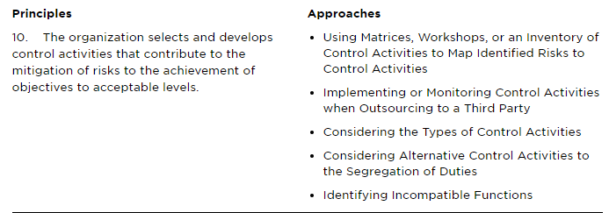
Used Framework to Map

