Slide 1
How can accounting educators integrating environmental, social, and governance (ESG) topics into the classroom?
AAA – Joint Meeting of the Mid-Atlantic and Northeast Regions
October 22, 2022
Ashley Stampone, University of Scranton
Veronica Paz, Indiana University of Pennsylvania
Christina Olear, Pennsylvania State University
Nicholas Olear, Pennsylvania State University

Slide 2
Importance of ESG - Industry
Majority of Fortune 500 companies offering voluntary reports on a combination of environmental, social, and governance topics (ESG), ESG disclosures have become increasingly important within the accounting profession.
Last year, the International Integrated Reporting Council (IIRC) and the Sustainability Accounting Standards Board (SASB) merged to create the Value Reporting Foundation (VRF) in hopes of creating a unified framework for ESG disclosures.
Similarly, the International Sustainability Standards Board (ISSB) was created in November of 2021 in hopes of obtaining the same outcome. This transition between SASB’s standards to the ISSB further highlights the combined and comprehensive focus on this important industry topic.
The SEC’s recent proposal to require public registrants to include certain climate-related disclosures has made ESG a critically important topic for today’s accounting professionals.
Lastly, the ISSB recently confirmed of Scope 3 GHG emission disclosure requirements
Public accounting firms, like PwC, have committed to investing millions of dollars and thousands of jobs related to ESG services for their clients

Slide 3
Importance of ESG - Academia
New AACSB standards emphasize the importance of including ESG and sustainability in business and accounting curricula.
CPA Evolution has also included sustainability as a point of focus on the new Business and Analytics Reporting (BAR) section.
Student also want to learn this:
Wyness and Dalton (2021) discuss the value undergraduate students receive in problem-based learning for sustainability related topics (https://doi.org/10.1016/j.jaccedu.2018.09.001).
Increases motivation, develops interest, and develops knowledge in various accounting, auditing, and reporting diciplines.
Pippen et al. (2021) surveyed 164 students from three universities about a variety of ESG topics. Approx. 70% of students said they would sign up for an ESG related accounting class if it fit into their schedule. (https://www.cpajournal.com/2021/11/12/integrating-sustainability-into-the-accounting-curriculum/)

Slide 4
Ways to Integrate ESG into the Classroom

Slide 5
Ways to Integrate ESG into the Classroom
Case Studies
ESG/Sustainability Related Projects
Certifications/Certificates
Professional and Outside Resources
Social Media and Podcasts
Guest Speakers
* Not a fully inclusive list—just ideas to help inspire you to integrate ESG into your classroom!

Slide 6
Case Studies
There are a variety of case studies from both academic and professional resources that can be integrated into the classroom.
Youngman, Julia Furr, Megan F. Hess, and Elicia P. Cowins. 2022. “Managing and Disclosing Environmental Risks: A Tale of Two Utilities.” Issues in Accounting Education 37 (3): 59–71. doi:10.2308/ISSUES-18-098.
Introduction to the topic of contingent liabilities by examining the actual management decisions of two energy companies facing increased regulatory scrutiny over the environmental risks associated with coal ash.
Learning Objectives: (1) research and summarizing guidance; (2) assessing a company’s decision regarding recognition and disclosure of environmental liabilities; (3) accounting for AROs; and (4) articulating the ethical implications of management and environmental risk disclosures from a stakeholder perspective.
Intermediate accounting

Slide 7
Case Studies
Peters, Matt D. 2022. “The Solar Panels Business Case: A Management Accounting Instructional Resource.” Issues in Accounting Education 37 (3): 141–67. doi:10.2308/ISSUES-2019-503.
Capital expenditure analysis and communication regarding grocery chain solar panel installment.
Three parts: (1) Prepare financial model with discounted cash flow method using Excel to analyze incremental capital expenditures, costs, profit impacts, and carbon dioxide emission savings; (2) Communicate the financial model using Word; and (3) present analysis using PowerPoint.
Undergraduate and graduate management accounting courses.

Slide 8
Case Studies
Bremser, Wayne G., Eva K. Jermakowicz, and Alan Reinstein. 2022. “Sustainability Reporting Insights: The Case of Ford Motor Company.” Issues in Accounting Education 37 (1): 125–39. doi:10.2308/ISSUES-18-032.
Learning objectives: (1) Explain concept of materiality in sustainability reporting; (2) Describe sustainability reporting requirements under GRI and SASB standards; (3) Evaluate differences in sustainability reporting choices between industry competitors; (4) Discuss motivations and challenges for preparers in regards to material sustainability issues; and (5) explain how investors and stakeholders can utilize sustainability reports.
Intermediate, advanced, or international accounting courses

Slide 9
Case Studies
Grimm, Stephanie D. 2021. “Junkyard Planet: Using Stories to Teach Managerial Accounting with a Sustainability Theme.” Issues in Accounting Education 36 (4): 253–80. doi:10.2308/ISSUES-19-063.
Discusses how sustainability was integrated into an accounting class using Adam Minter’s (2013) book Junkyard Planet.
Learning objectives: (1) Explain the differences between financial accounting and managerial accounting; (2) Classify costs as fixed, variable, or mixed; (3) trace flow costs; (4) CVP analysis; (5) Distinguish amongst costing methods; (6) Prepare master budget; (7) Prepare flexible budget; (8) Use standard costing to prepare variance analysis; (9) Prepare and interpret segment reports; (10) Use relevant cost data for strategic-decision making; (11) Apply managerial accounting concepts to the for-profit reuse and recycling industry; (12) Evaluate decisions related to costs and profitability from a sustainability and managerial accounting perspective; (13) Interpret economic data that influence the global markets for recycling; and (14) Describe how sustainability can be interwoven into the budget and planning process of organizations to decrease costs and increase profitability.
Managerial accounting courses

Slide 10
Case Studies
Brown, Veena Looknanan, and Mark J. Kohlbeck. 2017. “Providing Assurance for Sustainability Reports: An Instructional Case.” Issues in Accounting Education 32 (3): 95–102. doi:10.2308/iace-51582.
Discusses the procedures necessary to provide assurance on a sustainability report taking into consideration that procedures are nonstandard and may vary from client to client.
Learning objectives: (1) Perform research to gain an understanding of sustainability reporting and assurance, (2) Explain company rationales for wanting assurance on its sustainability reporting; (3) Evaluate the level of assurance that may be provided on a sustainability report; (4) Determine necessary assurance procedures; (5) Explain any potential independence issues in providing CSR assurance services.
Undergraduate and graduate accounting courses

Slide 11
Case Studies
McGuigan, Nicholas, Samantha Sin, and Thomas Kern. 2017. “Sourcing Sustainable Finance in a Globally Competitive Market: An Instructional Case.” Issues in Accounting Education 32 (1): 43–58. doi:10.2308/iace-51304.
Provides students with the opportunity to apply theoretical and social accounting concepts through the creation of a business loan application intended to procure finance for an investment that benefits society or the environment.
Learning objectives: (1) integrate and apply knowledge acquired in the course for decision-making and solving problems in business contexts; (2) Acquire written and oral communication skills; (3) Give and receive feedback to make improvements, and (4) develop an awareness of the importance of sustainable business practices and broader stakeholder consideration.
Introductory finance and accounting courses.

Slide 12
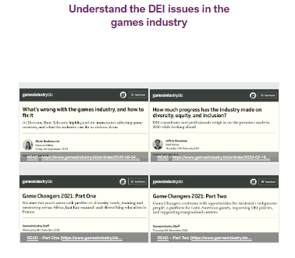
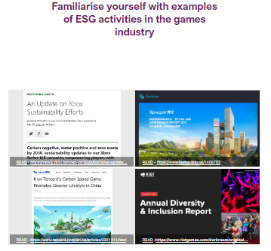
ESG/Sustainability Projects
Instead of following a step by step case, integrate ESG/Sustainability accounting projects into your classroom:
Integrate CSR reports and have students compare and contrast two or three companies within the same industry.
Assign a project where students analyze the 10-K of a company and the corresponding CSR report of that same company to see the relationship between financial and sustainability reporting.
Integrate gamification tools: Pixx-wizz Business Game (ESG focused) (office.com)

Slide 13
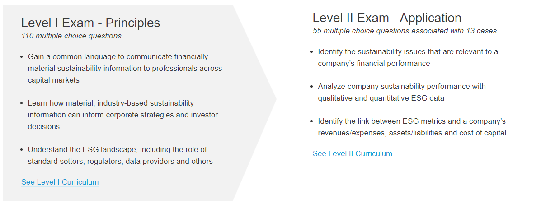
Certifications/Certificates
Fundamentals of Sustainability Accounting (FSA) Credential: link between financial material sustainability information and company’s ability to drive value.
FSA-Curriculum-L1L2-Outline-052622.pdf (sasb.org) Level-2-Curriculum-1.pdf (sasb.org)

Slide 14
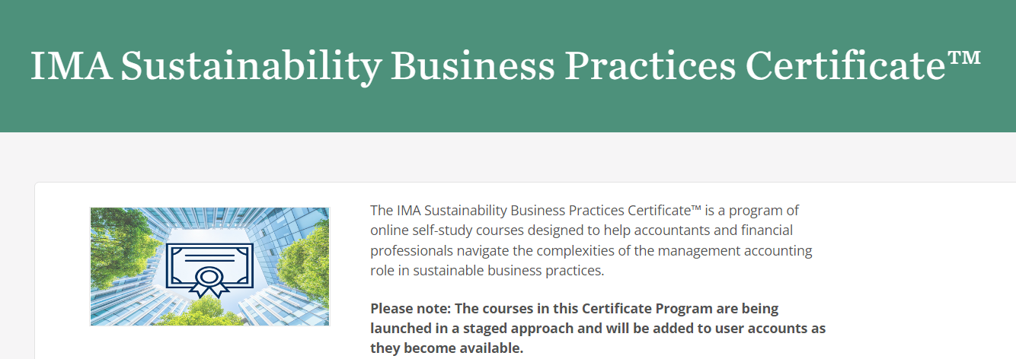
Certifications/Certificates
IMA Sustainability Business Practices Certificate:
https://imaonlinestore.com/personifyebusiness/Product-Details/productId/92412079?_ga=2.154454512.954919962.1663944317-84195983.1663944317

Slide 15
Professional Resources and Outside Readings
International Sustainable Standards Board: https://www.ifrs.org/groups/international-sustainability-standards-board/
AICPA has a great hub for ESG related publications and resources:
Considerations of ESG-related matters in an audit of financial statements: https://www.aicpa.org/resources/download/considerations-of-esg-related-matters-in-an-audit-of-financial-statements
Key actions for establishing effective governance over ESG reporting:
https://www.aicpa.org/resources/download/key-actions-for-establishing-effective-governance-over-esg-reporting
ESG reporting and attestation: A roadmap for audit practitioners: https://www.aicpa.org/resources/download/esg-reporting-and-attestation-a-roadmap-for-audit-practitioners
https://insights.cgma.org/story/esg-assurance/page/6/1

Slide 16
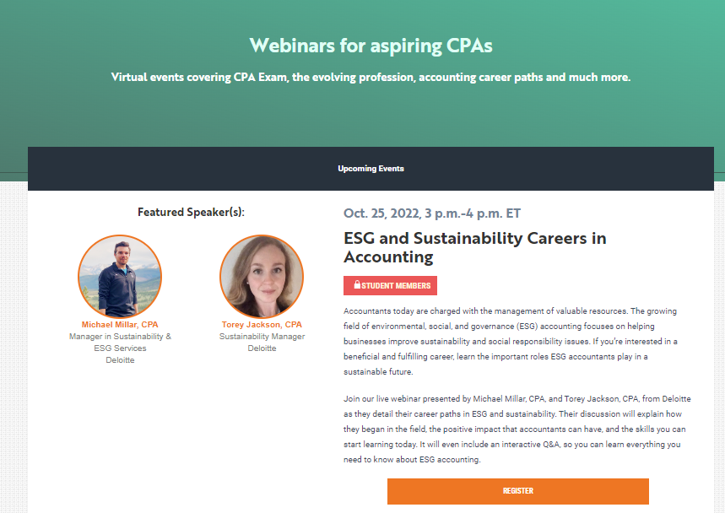
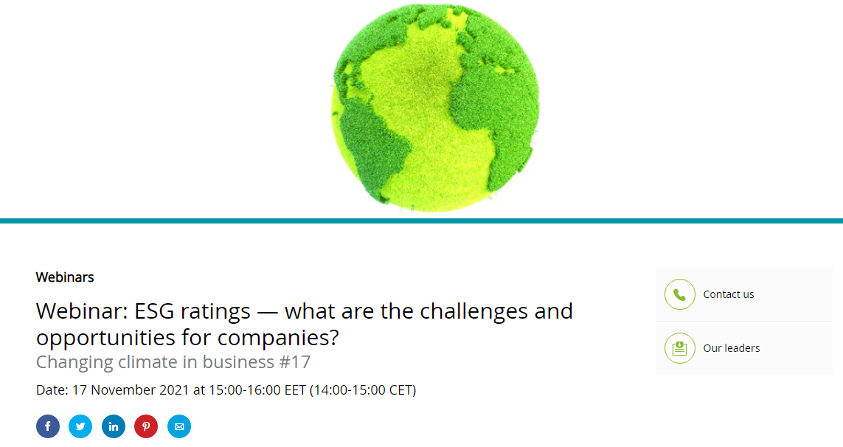
Professional and Outside Resources
Webinars: https://thiswaytocpa.com/webinars/
https://www2.deloitte.com/ro/en/pages/about-deloitte/events/webinar-esg-ratings-what-are-the-challenges-and-opportunities-for-companies.html

Slide 17
Professional and Outside Resources
https://www.cimaglobal.com/Events/Events/Mastercourses/Technical-skills/Financial-accounting-and-reporting1/Sustainability-reporting/

Slide 18
Professional Resources and Outside Readings
Firm Resources:
PwC: https://www.pwc.com/us/en/services/esg/library/sec-climate-disclosures.html?WT.mc_id=CT3-PL300-DM1-TR1-LS3-ND30-PRG7-CN_ESG-Google&gclid=Cj0KCQjwqc6aBhC4ARIsAN06NmOe1EqwDvQvK3pv8YnO-RNTb4uSJ6JfAUUygktpyIYPAqhlWsfX84IaAhQUEALw_wcB&gclsrc=aw.ds
Deloitte: https://www2.deloitte.com/us/en/pages/audit/solutions/corporate-sustainability-reporting.html
KPMG: https://home.kpmg/xx/en/home/services/advisory/risk-consulting/internal-audit-risk/sustainability-services/sustainability.html
EY: https://www.ey.com/en_us/esg-reporting

Slide 19
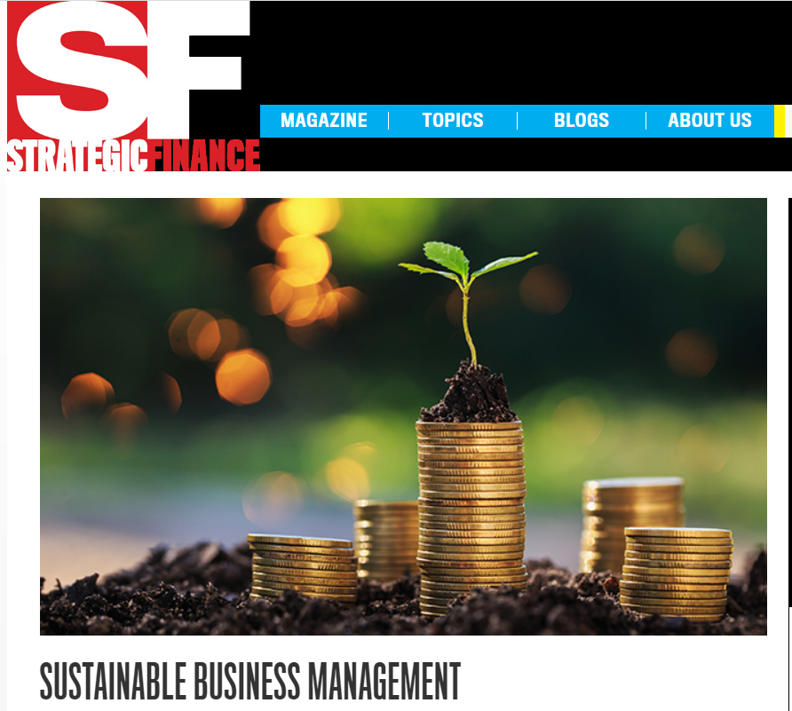
Professional Resources and Outside Readings
Professional Resources:
Journal of Accountancy
https://www.journalofaccountancy.com/newsletters/extra-credit/sustainability-accounting-education.html
CPA Journal
https://www.cpajournal.com/2022/10/19/the-relevance-and-reliability-of-esg-reporting/
https://www.cpajournal.com/2022/10/21/embedding-sustainability-into-practice/
Strategic Finance
https://sfmagazine.com/issue/april-2022/
https://sfmagazine.com/post-entry/january-2021-financial-and-sustainable-reporting-converge/
https://sfmagazine.com/post-entry/november-2019-taking-the-lead-on-sustainability-efforts/

Slide 20
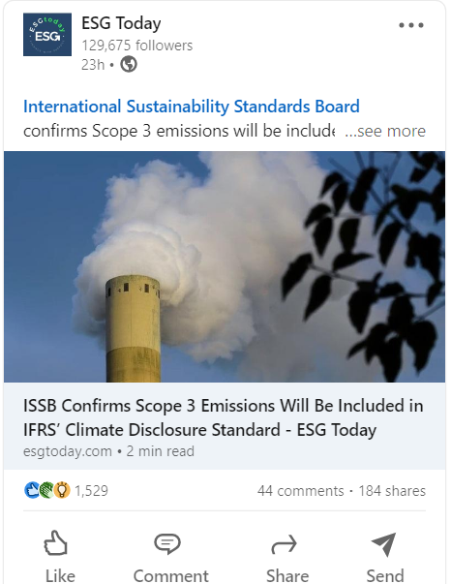
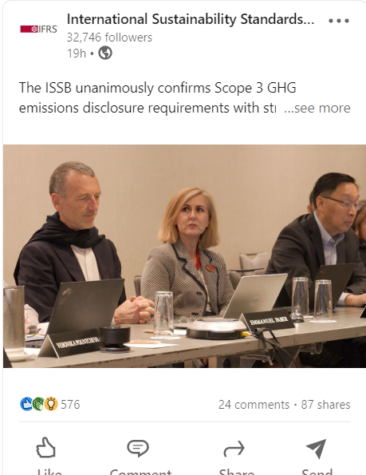
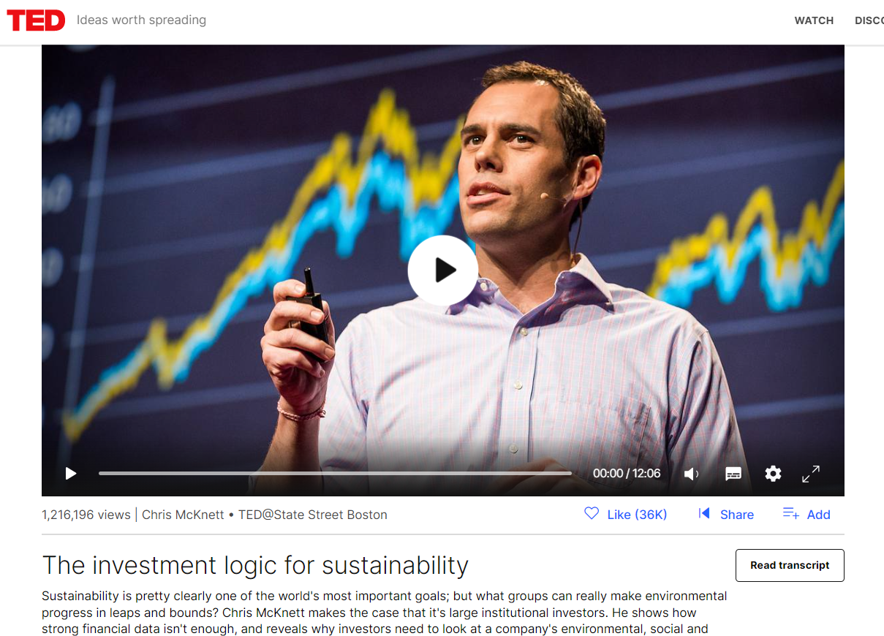
Social Media and Podcasts
Ted Talks
LinkedIn: ISSB, SASB, ESG Today
Podcasts: Count Me In (IMA)
“ESG from a Finance Perspective,” ep. 121, May 2021
“How do CFOs Influence ESG?”, ep. 111, Feb 2021

Slide 21
Guest Speakers
You can bring in guest speakers to discuss real-world experiences and to facilitate classroom discussions.
ESG Directors, Chief Sustainability Officers, Partners in ESG related fields.
Invite professionals from your local area to talk to your classes!

Slide 22
Be Creative
ESG is an exciting topic that students want to learn about!
Don’t be afraid to start with smaller items such as readings and articles, and move to more time-intensive tasks such as projects and case studies.
Be creative in how you integrate ESG into your classes!

Slide 23
Questions?
Thank you!

