Slide 1
Using Kahoot as a Tool to Review Class Material
By
Tim Creel, Lipscomb University
Veronica Paz, Indiana University of Pennsylvania
Chris Olear, Penn State University

Slide 2
What is Kahoot!
Allows the preparation of quizzes in a fun environment
Is free for faculty and students
Can be used to review regular material or for test reviews
Works in both an online and campus class
Can be used for polling features as well as quizzes

Slide 3
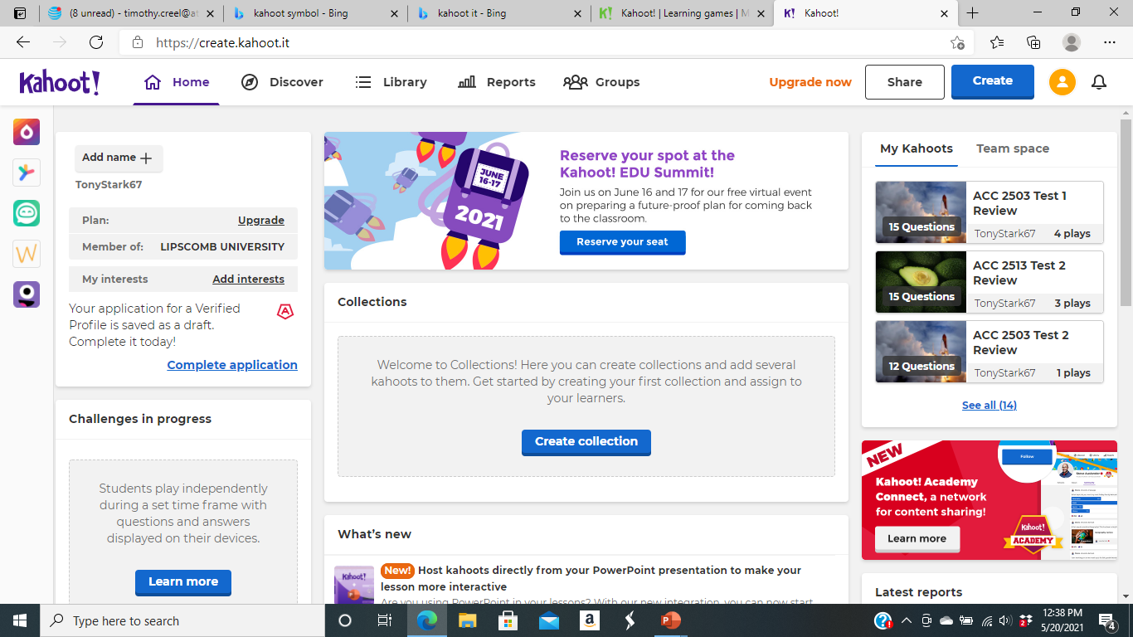
Using Kahoot to Review Material
Go to Kahoot! | Learning games | Make learning awesome!
Set up a free account
Build your Kahoot

Slide 4
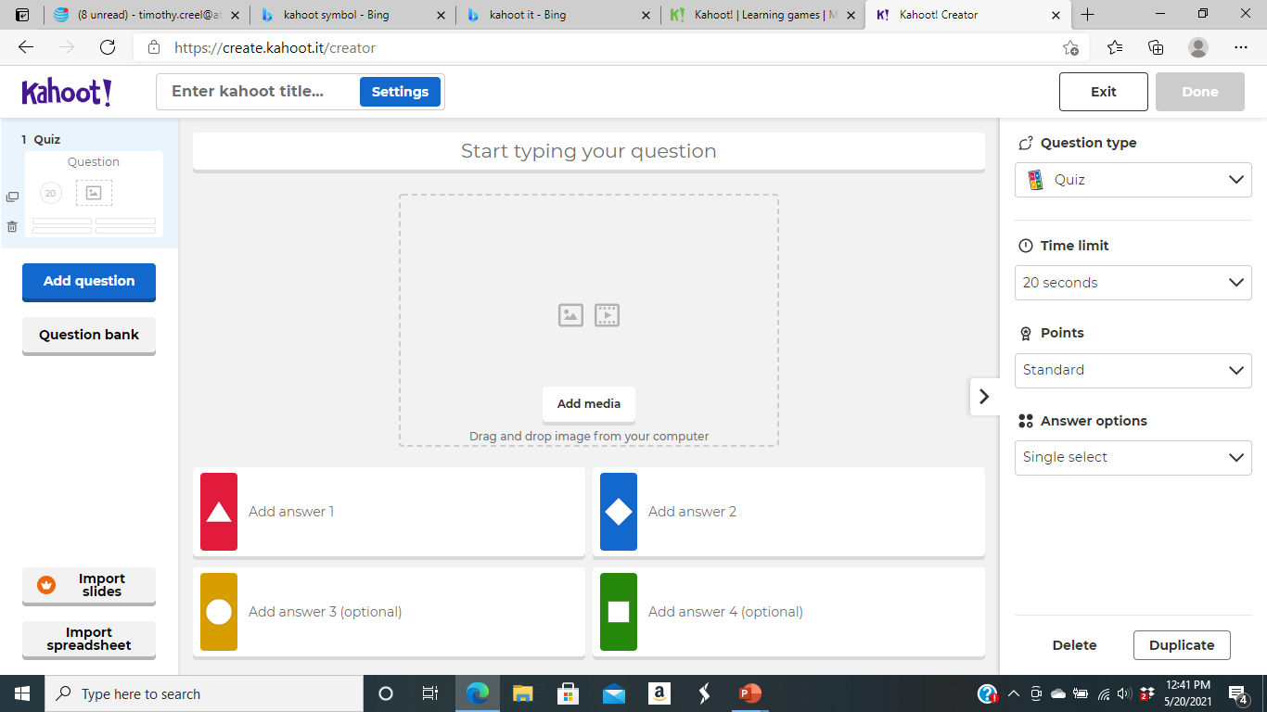
Create New Kahoot
Build each question for your Kahoot. Include pictures to improve the experience.

Slide 5
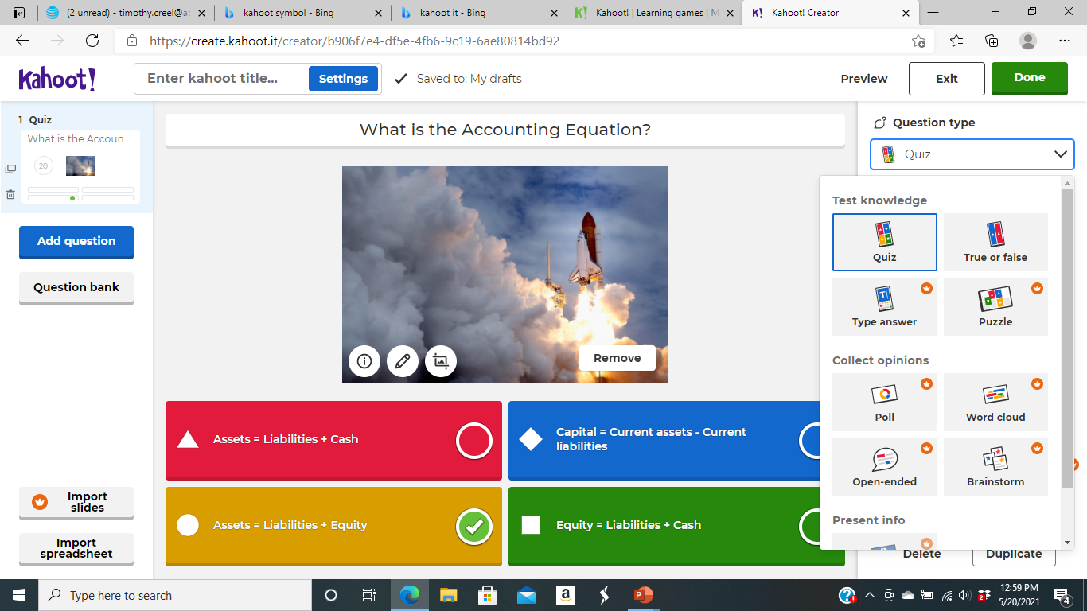
Choose your Type of Review
You can choose standard quiz with multiple choice, true or false, type answer or even create a puzzle for students. You may want to use it for polling to see how students are grasping some concepts.

Slide 6
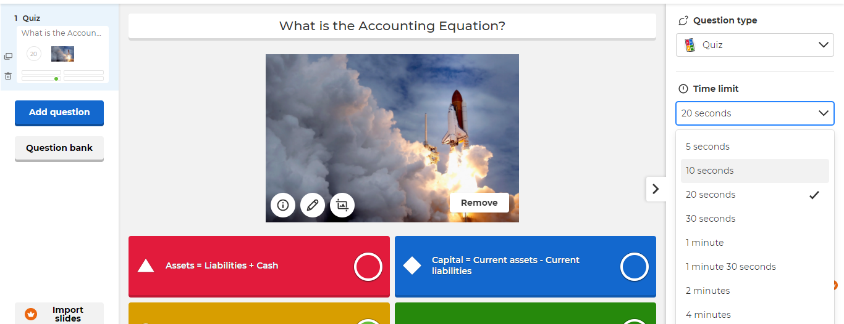
Set the time for the Question
Can give longer amounts of time for more complex questions

Slide 7
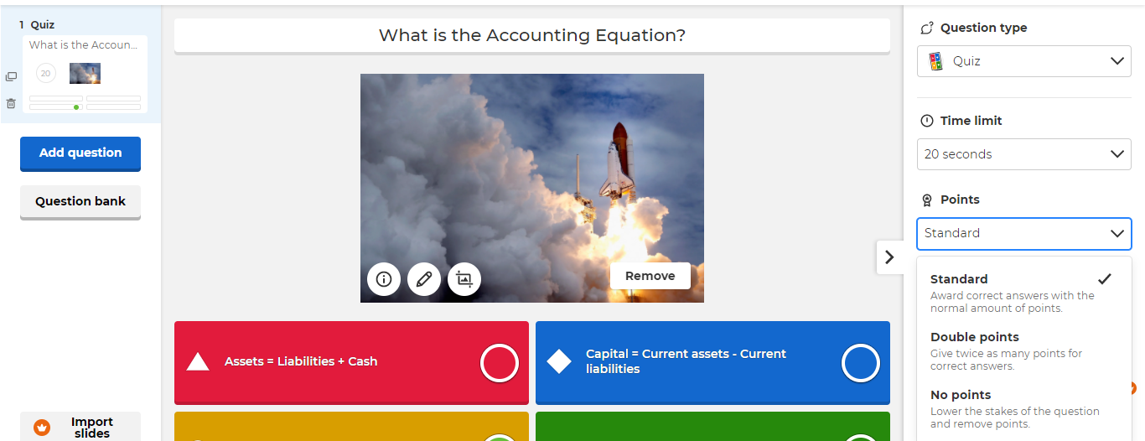
Set points for the Quiz
Stick with the standard or set points based on your objectives

Slide 8

Choose your answer options
Can choose singe or multiple answers

Slide 9
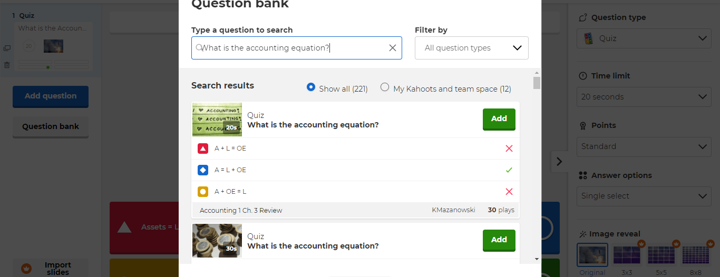
You can always search for questions in the question bank
Many questions are available on many topics

Slide 10
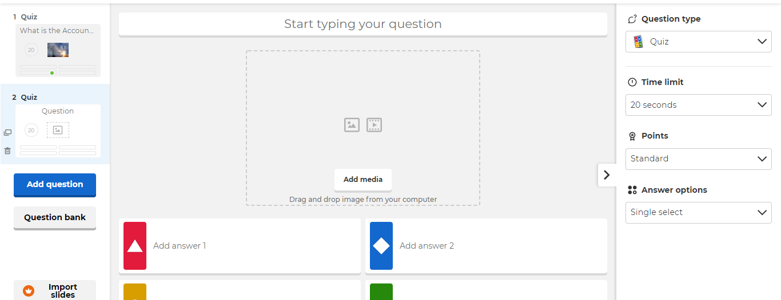
Add a name to your quiz and add more questions.
Create next question and build your quiz.

Slide 11
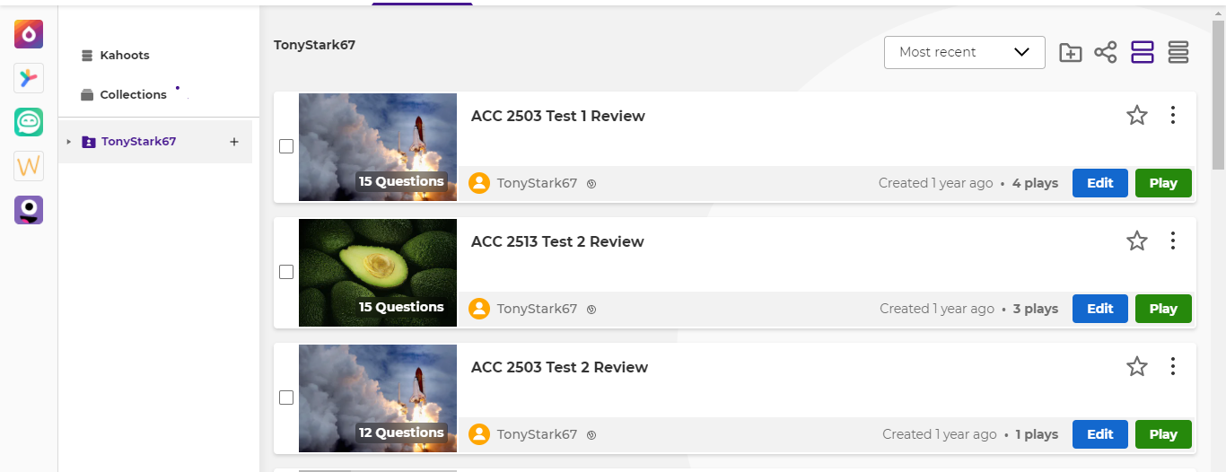
Quiz Library
You can build up a number of quizzes that can be updated and reused in the future.

Slide 12
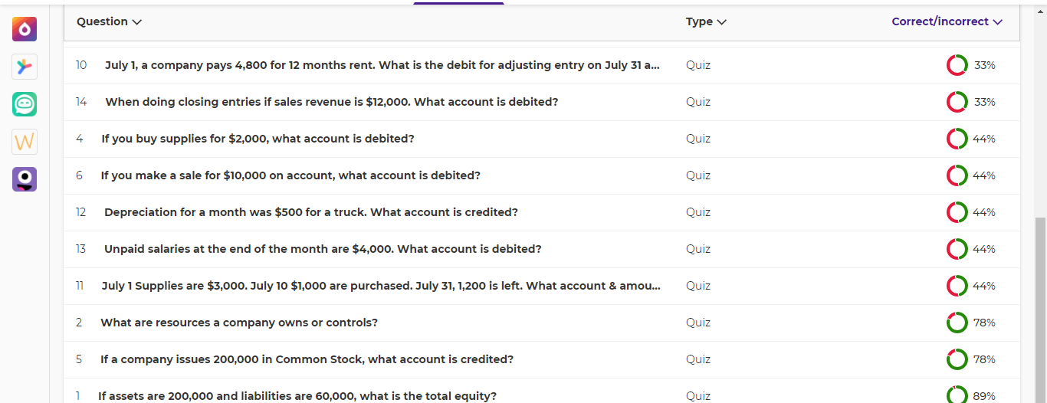
Kahoot collects information about quiz performance
Information is available about question and student performance

Slide 13
Ideas for Kahoot
Use to review for a test
Use to review last class material
If used for a review, go over the materials between questions
Make it fun with music and encourage creative names as I am Tony Stark
You can offer extra credit for the top three students on the podium
You can send a link to online classes so they can take it
Review the results to see areas where students did not do well
You have the ability as host to kick out any inappropriate names chosen by students. I let them know this upfront.

