Slide 1
New Technologies for an Accounting Class
Dr. Veronica Paz, CPA, CITP, CFF, CGMA
Professor of Accounting and Information Technology

Slide 2
Technologies Taught in the Classroom

Slide 3
Data Mining
https://idea.caseware.com/learn/idea-academic-programs/
https://www.alteryx.com/sparked/educators

Slide 4
Visualization Software

Slide 5
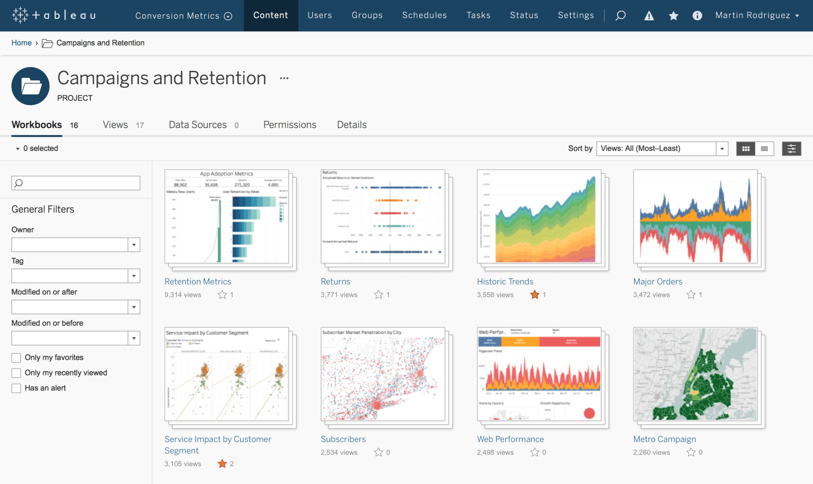
Tableau
https://www.tableau.com/academic/students

Slide 6
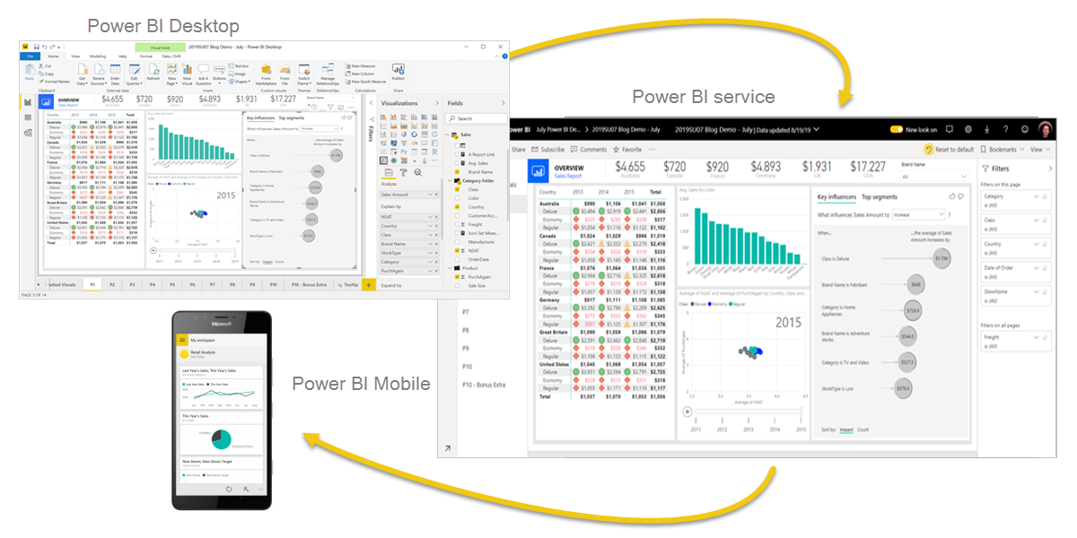
Power Bi

Slide 7
Robotic Process Automation

Slide 8
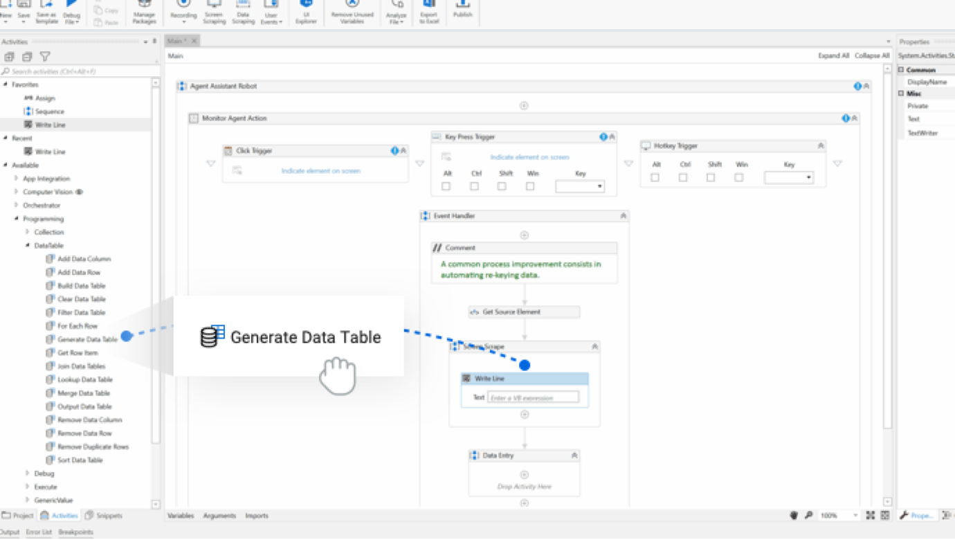
UiPath
https://www.uipath.com/rpa/academic-alliance

Slide 9
Technologies Utilized in the Classroom

Slide 10
Engagement Tools

Slide 11
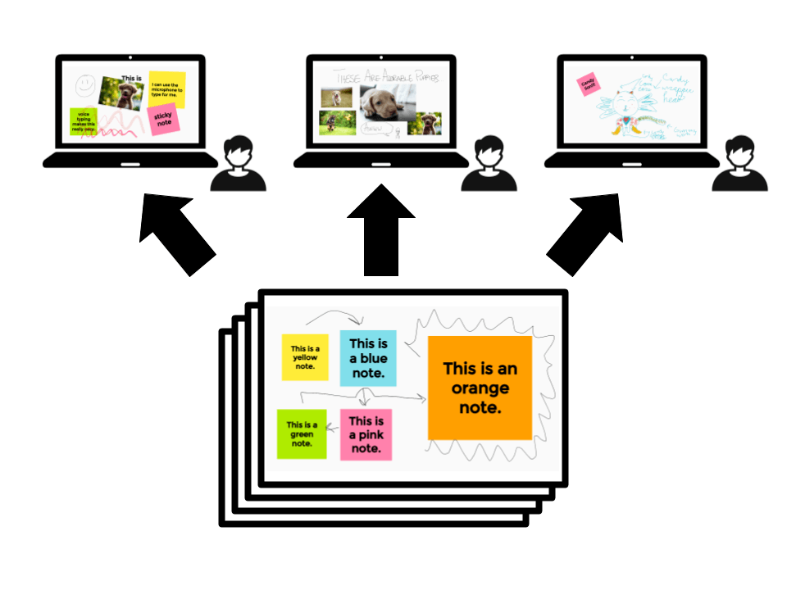
Google Jamboard
https://jamboard.google.com/

Slide 12
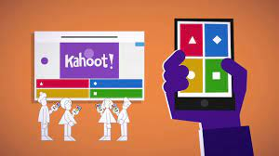
Kahoot
https://kahoot.com/

Slide 13
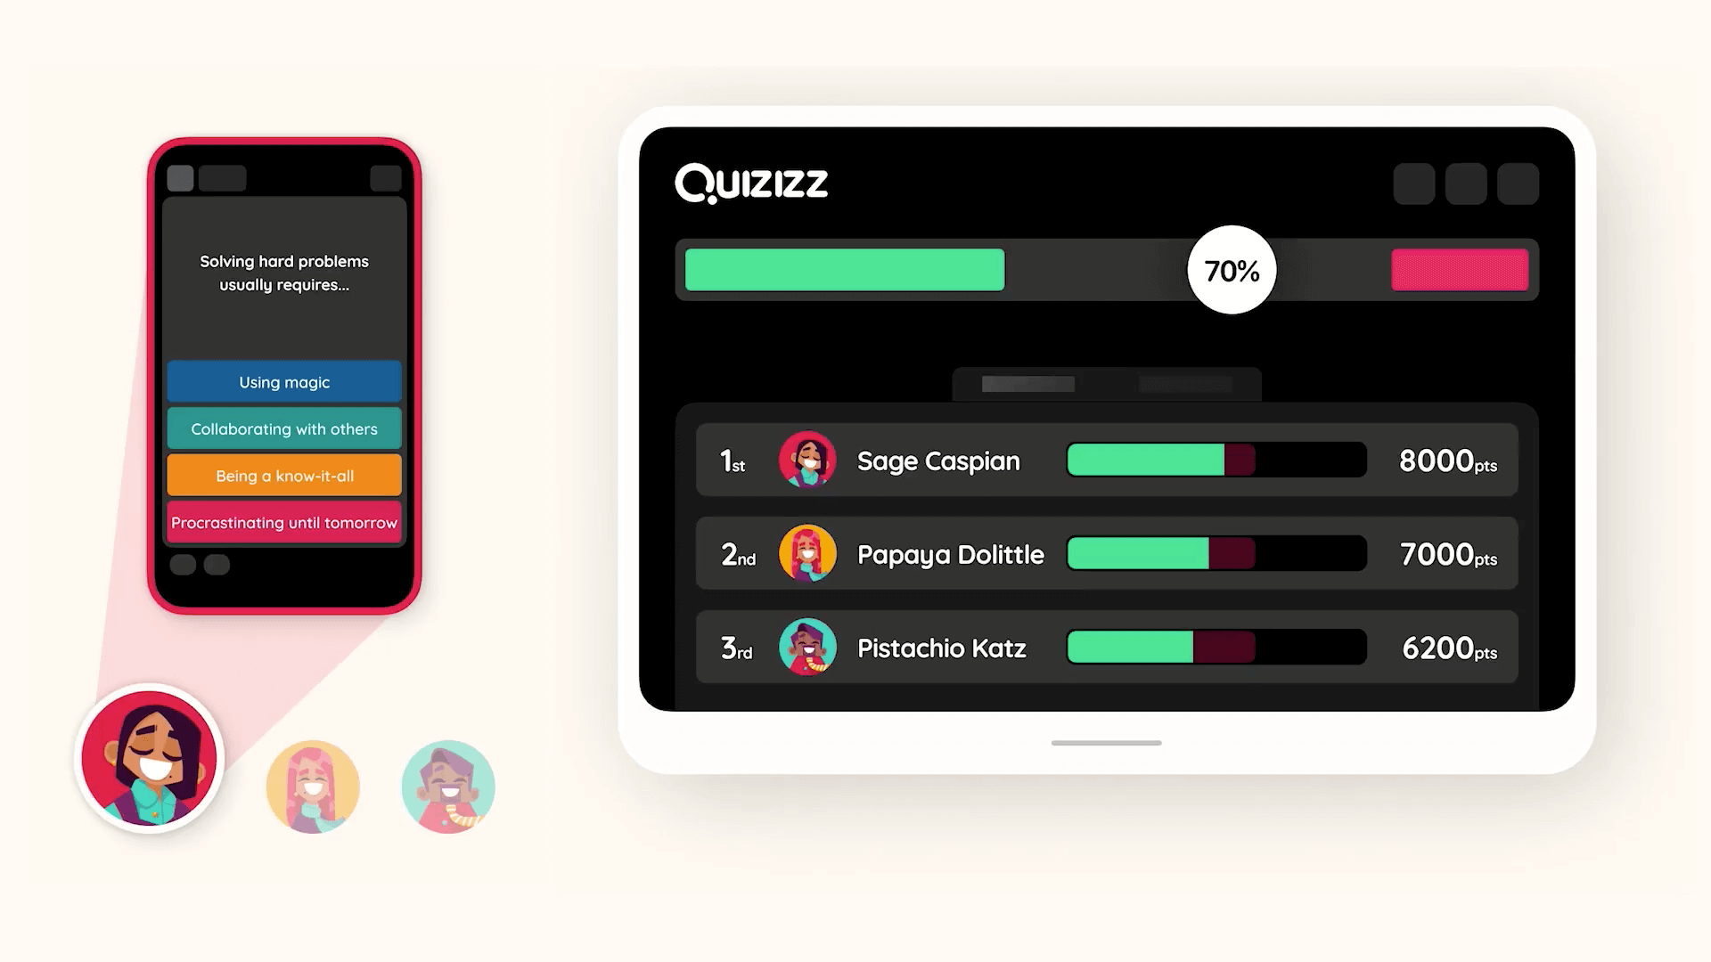
Quizizz
https://quizizz.com/

Slide 14
GoSoapBox
https://www.gosoapbox.com/

Slide 15
Software for Content Development

Slide 16
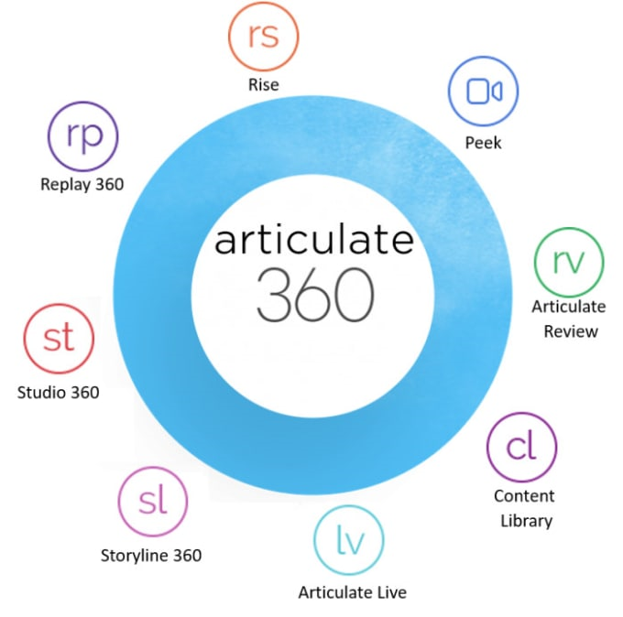
Articulate 360
https://articulate.com/360

Slide 17
Microsoft Sway
https://sway.office.com/

Slide 18
Genially
https://genial.ly/

Slide 19
PiktoChart
https://piktochart.com/

Slide 20
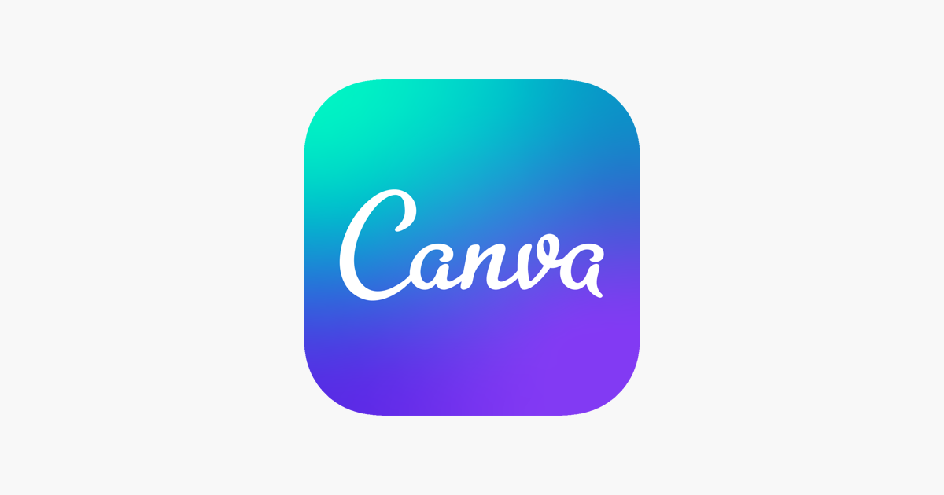
Canva
https://www.canva.com/

Slide 21
Presentation Tools
Canva (presentations, reports, tons of templates! free or paid subscriptions): https://www.canva.com/
Piktochart (beautiful infographics, reports, presentations. free or paid subscriptions): https://piktochart.com/
Edpuzzle (use videos, even your own, and add questions into it): www.edpuzzle.com, https://www.youtube.com/watch?v=-L62wAxCzEM&vl=en-US
Nearpod (blends assessment with multimedia): www.nearpod.com
Playposit (embed questions into videos): https://go.playposit.com/, https://www.youtube.com/watch?v=uWAcAX8bgAs

Slide 22
Video & Multimedia Tools

Slide 23
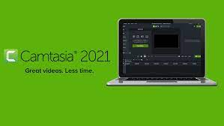
Camtasia
https://www.techsmith.com/video-editor.html

Slide 24
Screen Cast O Matic
https://screencast-o-matic.com/

Slide 25
Video Resources
Recording to the cloud in Zoom https://support.zoom.us/hc/en-us/articles/203741855-Cloud-recording
Screencast O Matic (video recording, editing, captioning. Free or Paid - $1.65/monthly): https://screencast-o-matic.com/, https://screencast-o-matic.com/tutorials
Biteable (creating animated videos, free or paid): https://biteable.com/team/
Editing videos in iMovie (if you are working on a Mac): https://support.apple.com/en-us/HT210430

Slide 26
Several Resources

Slide 27
Free & Open Resources
Name | Location | Category
Adobe Color | https://color.adobe.com/ | Color Schemes
Google Material Palette Generator | https://edtechbooks.org/-cutj | Color Schemes
Dafont | https://www.dafont.com/ | Fonts
Font Squirrel | https://www.fontsquirrel.com/ | Fonts
Google Fonts | https://fonts.google.com/ | Fonts
Feather Icons | https://feathericons.com/ | Icons
Font Awesome | https://fontawesome.com/ | Icons
Glyphicons | https://www.glyphicons.com/ | Icons
Google Material Design Icons | https://edtechbooks.org/-nyzz | Icons
The Noun Project | https://thenounproject.com/ | Icons
Flickr CC | https://edtechbooks.org/-CuEQ | Images
Freepik | https://www.freepik.com/ | Images
Pexels | https://www.pexels.com/ | Images
Pixabay | https://pixabay.com/ | Images
Undraw | https://edtechbooks.org/-xno | Images
Unsplash | https://unsplash.com/ | Images
Vecteezy | https://www.vecteezy.com/ | Images
Wallpapers.io | https://wallpapers.io/ | Images
Wikimedia Commons | https://commons.wikimedia.org/ | Images
A List of Free Online Resources by Category
https://edtechbooks.org/design/open_resources

Slide 28
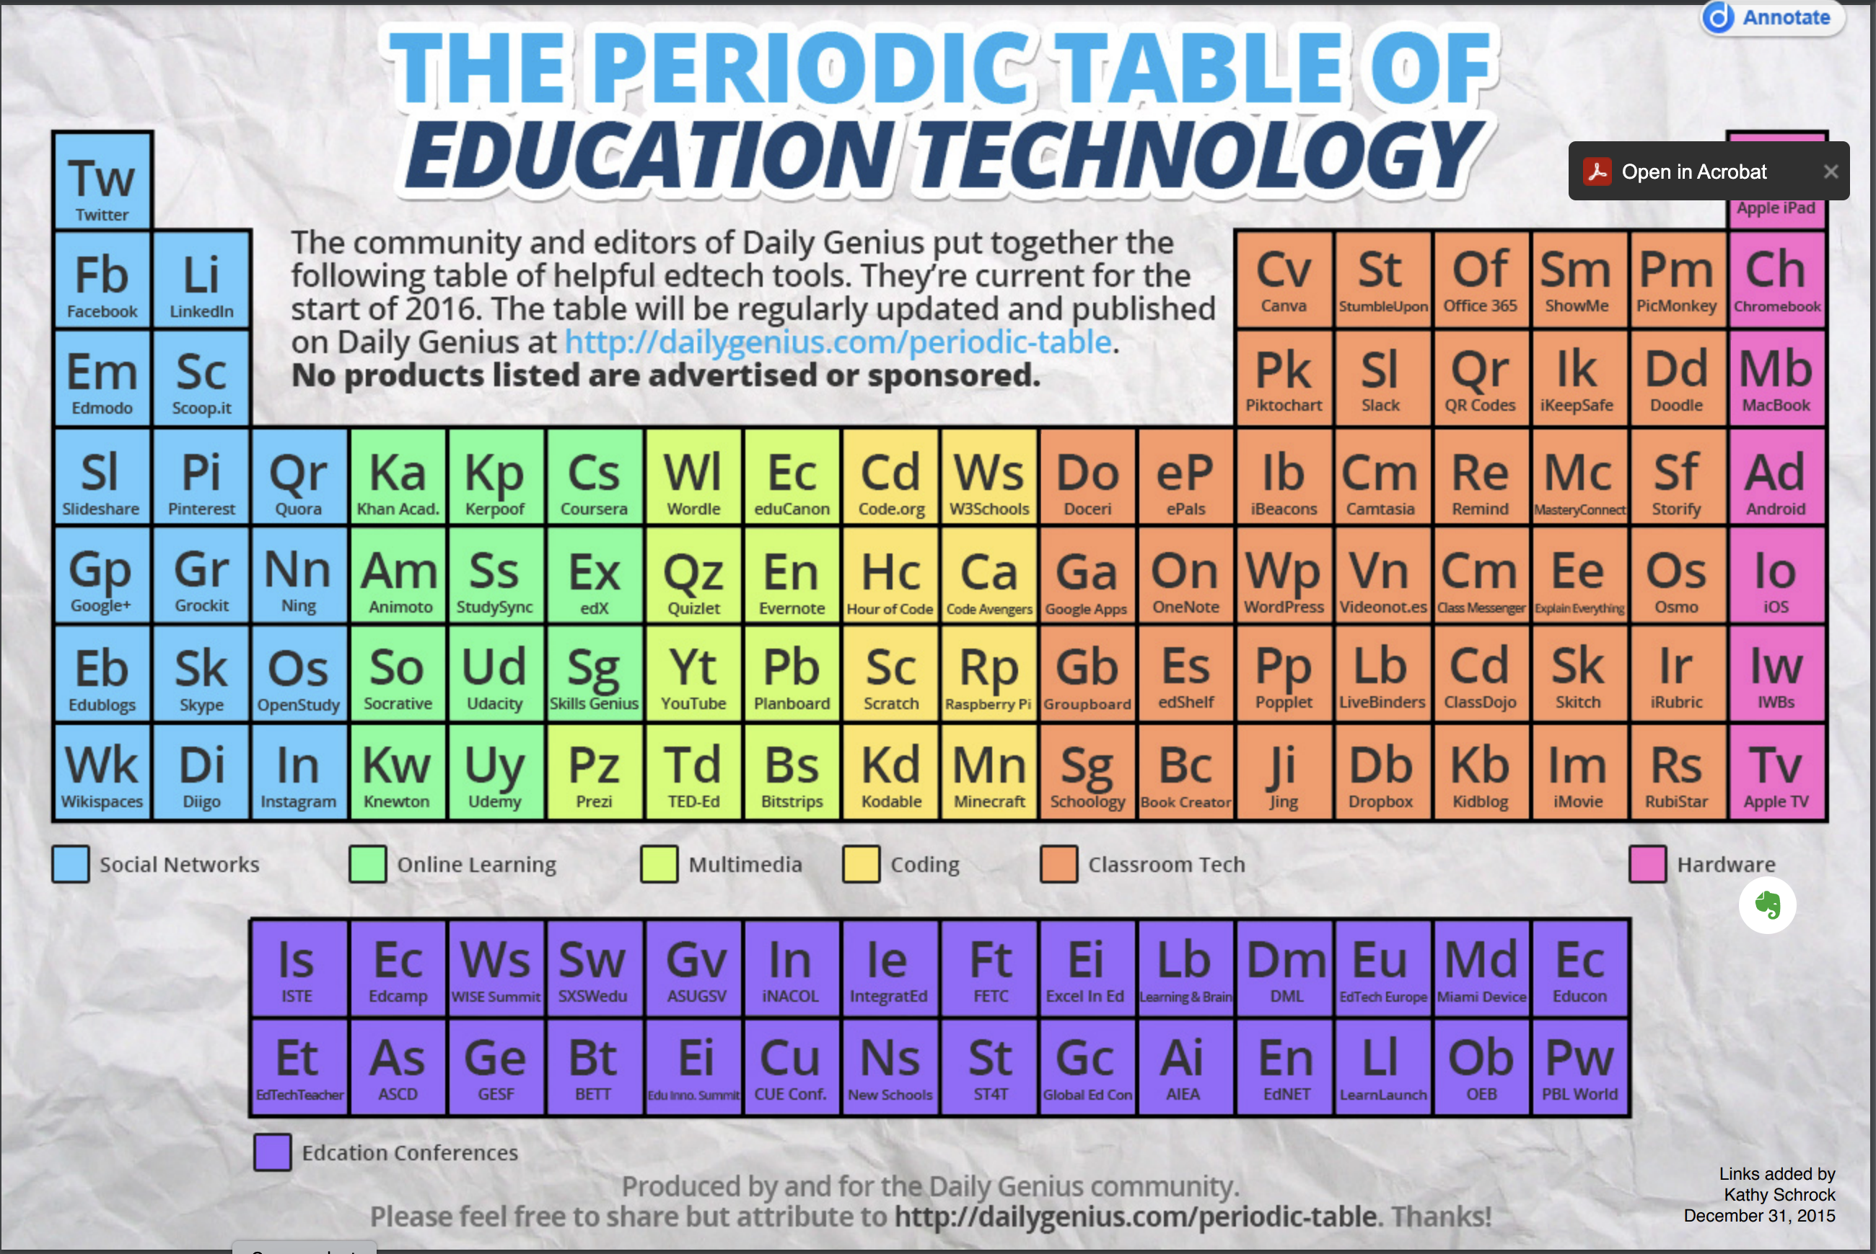
Periodic Table of Education Technology
http://www.schrockguide.net/uploads/3/9/2/2/392267/edtech_periodic-table.pdf

Slide 29
Google JamBoard
Now let’s get your thoughts on the technology presented and practice with Google jamboard
https://jamboard.google.com/d/1Ibb28yXJP0rYkZ02fK924aU3r8C3jthq1b3DUWZsKrk/edit?usp=sharing

Slide 30
Dr. Veronica Paz, CPA, CITP, CFF, CGMA
Webpages
https://www.drvpaz.com/
https://www.AccountingTeachingTools.com
Contact Information
veronica@veronicapazcpa.com
724-590-9164
Faculty Page
https://www.iup.edu/accounting/faculty/paz-veronica.html

