Slide 1
Best Practices, Tips, and Tricks for Accounting Courses in a Distance Learning Modality
Veronica Paz, Indiana University of Pennsylvania
Samantha Marie Dzielski, Indiana University of Pennsylvania

Slide 2
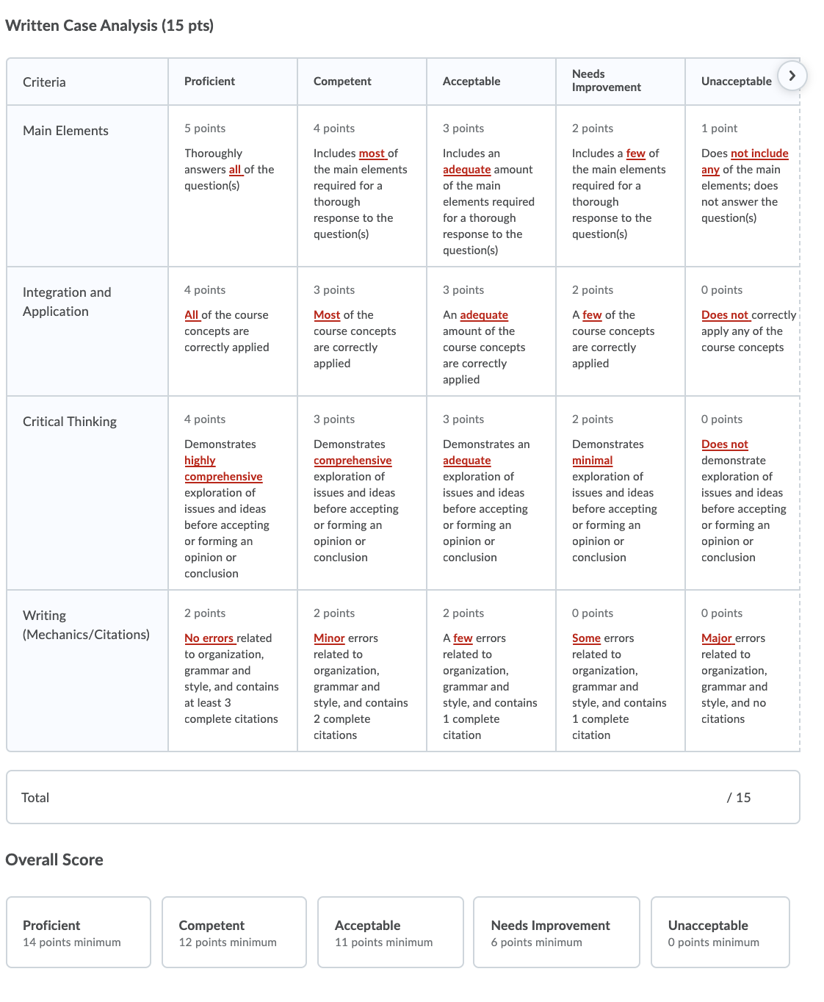
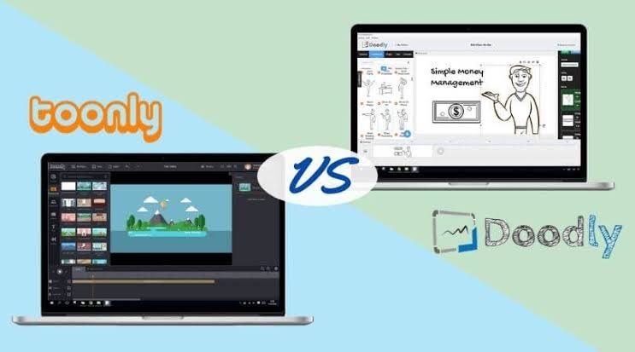
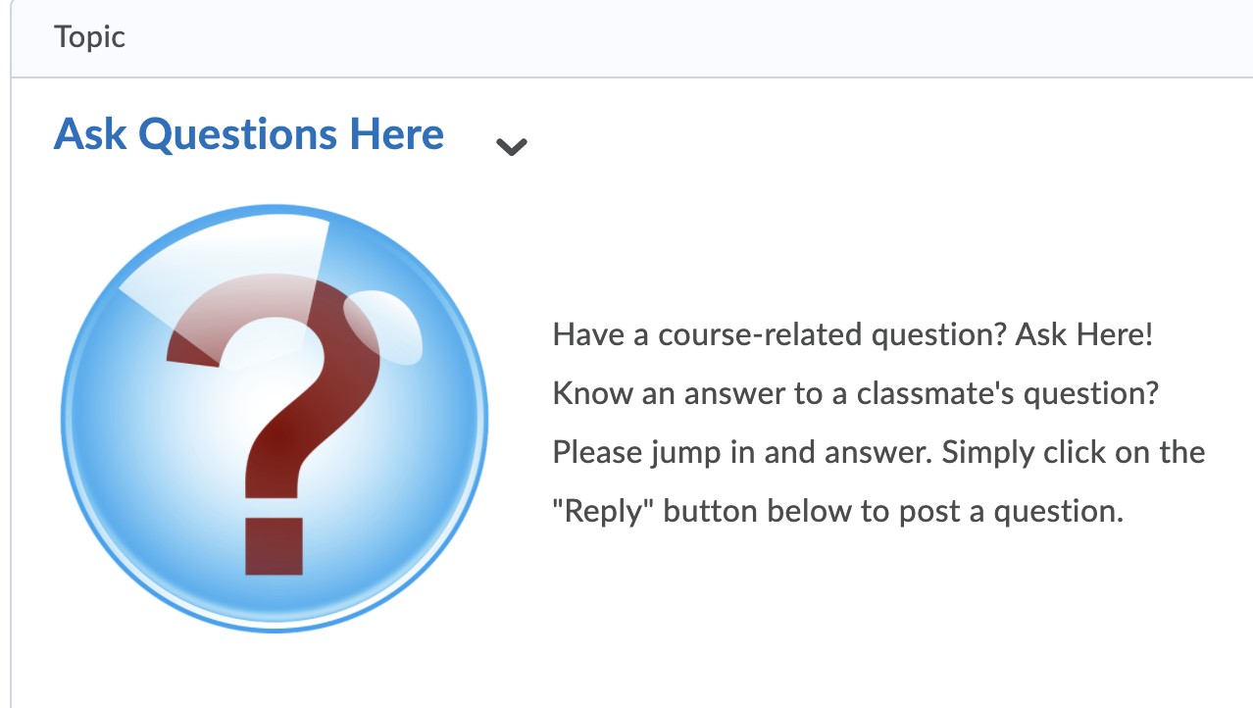
Distance Learning Teaching Tips and Best Practices
Veronica Paz & Samantha Dzielski
Indiana University of Pennsylvania
www.drvpaz.com
ORCID QR Code
ORCID QR Code
Introduction
Course Administration
Communication
Modules
Assessment
Online courses are rapidly growing, and distance learning was forced upon us due to COVID-19. The authors present a structure and framework for online or Distance Education accounting course delivery.
Advantages and Disadvantages to Distance Learning
Advantages
Participate any time from anywhere
Asynchronous written communication
Video lectures (Bettinger, Fox, Loeb, & Taylor, 2017)
Greater time flexibility
Reduced costs
Better fit for students' lifestyle (Salimi, 2007; Shanahan, 2003)
Disadvantages
Top 3 concerns (Richards, Stevens, Silver & Metts 2018)
Integrity
Opportunities, Live interaction
Effective Course Design
Course Administration
Start with a Teaching Plan.
First page students see is home or landing page and it is an inviting place to be. Post short video 1-2 minutes showing your students how to get to the home page and welcoming them.
Create a Master course and make changes to this course throughout the semester not the live course.
Try to keep all materials in the LMS for efficiency.
Start Here
Should be a separate and first module notifying the students as to what they should do first
Before You Begin course page directing student to critical information before starting the first module. Could include time management skills and Top 10 List to succeed in this course.
Provide
The syllabus,
Video reviewing the syllabus, and
a syllabus quiz. All of this is a prerequisite to open other learning modules.
Communication is a crucial part of any course irrespective of modality.
Instructors should be minimally active in the discussions.
Use email frequently (Dennen et al., 2007, Gayton & McEwen, 2007)
Email the syllabus and FAQ to students before the stat date of class.
Instructor Presence
Provide guidance in a discussion activity, answer student questions and provide formal assessment feedback (Arghode, Brieger, & McLean 2017).
Post frequent announcements, including module summaries, reminders for upcoming assignments and clarification on learning activities.
Discussion Forums
Provide a discussion forum specifically for general student questions. Encourage students to answer other students’ questions for collaborative learning.
Online courses should be separated into learning modules of units.
Start the module with an outline of the module, use stories, use infographics and tell a story around a visualization.
Provide access to PowerPoints and other supplemental learning resources. Consider using video lectures to increase student engagement. Keep the student’s attention in a 3–5-minute video.
Utilize virtual teams, games, case studies.
Interactive Exercises
Doodly (https://www.doodly.com/ ), a whiteboard animation software, Toonly (https://www.toonly.com/ )
Assessments are prevalent in all courses. Marriott and Lau (2008) report how technology has been used to improve student learning.
Use the LMS for creation of drop boxes for all assessments. Current Event assignments can pique students' interest.
Keep assignments due on the same day for consistency.
Use rubrics.
Be sure to provide detailed feedback and return assessment with the week, preferably three days from submissions.
Communicate to students in advance when assignment and exams will be graded and returned.
References: See attached.

Slide 3
Objective: How can educators who may have experienced a traditional classroom setting as an undergraduate, make their courses engaging in an online format?
Contribution: In an environment where students want more flexibility in their education, this paper shares tools and tips educators can incorporate into their courses to engage students without standing in front of the classroom lecturing.
Significance: With an increasing number of students choosing online education, flexible courses will appeal to a more diverse student population.

Slide 4
Background
1 out of 3 students enrolls in at least one course online during their college career.
This has increased threefold over the past decade (Allen & Seaman, 2013)
5.8 million students took at least 1 online course in 2016 (Online Learning Consortium, 2016)
Universities with 15,000 students or more offer some form of online instruction (Figlio, Rush & Yin, 2013)
National online enrollment rates are increasing more rapidly than face-to-face courses (Ni, 2013).
Traditional classrooms are declining while online learning is growing (Tabatabaei & Gardiner, 2012).
Increased demand for and access to online education in the US (Allen & Seaman, 2013).
The internet has provided a platform for standardized delivery of online courses; improved strategic importance, popularity, perceived quality of online learning (Thomas, 2011)

Slide 5
Distance Learning Advantages
Different role for the professor
Standardized inputs (traditionally vary between professor)
Lectures are recorded video (Bettinger, Fox, Loeb, & Taylor, 2017)
Different constraints and expectations of academic interactions
Interactions are typically through asynchronous written communication
Time flexibility (Salimi, 2007; Shanahan, 2003)
Students can participate anytime, from any place
Can better fit a student’s lifestyle (Salimi, 2007; Shanahan, 2003)
Reduced cost (Salimi, 2007; Shanahan, 2003)

Slide 6
Benefits of Online Courses
For the professor (Dumont & Raggo, 2018):
Work remote
Flexible schedule
Innovating with course design and delivery
For the student (Salimi, 2007; Shanahan, 2003):
Flexible schedule
Reduced cost savings
Personal and professional life balance
Greater time management

Slide 7
Distance Learning – Top 3 Concerns (Richards, Stevens, Silver, & Metts, 2018)
1. integrity of online courses
2. opportunities for live interaction
3. design of effective courses (most professors lack the knowledge to design effective courses)

Slide 8
Academics are experts in their field. In traditional or face-to-face formats, they engage and inform the students in the same manner they were taught (Dumont & Raggo, 2018).
Distance or online learning requires a structure and framework.

Slide 9
Course Administration
Course Homepage
Inviting
Short video of yourself welcoming the students
Use different multimedia aspects, infographics
ALL materials in LMS
Links to external sources, websites as examples
Automate the quizzes and grading

Slide 10
Start Here
Before you begin; this page tells the students how to start the course
(Detailed!) Video reviewing the syllabus
Syllabus Quiz
T/F or MC questions
Students must take the quiz and earn a passing score to unlock the modules
FAQ
Netiquette Guidelines; Provide behavior expectations

Slide 11
Communication
Announcements 3-5 times per week
Emails
(Virtual) Office Hours via Zoom or appointment tools like Appointlet or Signup Genius
Optional Synchronous Sessions (recorded for those who cannot attend)
Milestone project reviews
Clarification
Review challenging topics
One week before the start of the course; how to access the course.
To students missing submissions.
Module Summaries
Reminders
Clarification
Current events within standard-setting bodies (PCAOB, AICPA, ACFE, FASB)

Slide 12
Discussion Forums
Introduction Forum
Ice Breaker
Allows student to introduce themselves
Student Goal Expectations
What do you want to get out of this course?
What strengths do you bring to the class?
What are your concerns about online learning?

Slide 13
Modules
Checklist
Lessons
Online Lectures
Short & Sweet
3-5 minutes, like a song
Animations for Roleplaying scenarios
Case Studies
To Do List
Deliverables

Slide 14
Assessments
Dropbox (LMS tool)
Reflection Assignments
Current Event Assignments
Wall Street Journal
Forbes
Accounting Today
AICPA Publications
Incorporate more written communication in accounting courses
Assignment submissions accepted via email is counterproductive

Slide 15
Grading
Weekly
Rubrics
With detailed feedback
For all assignments

Slide 16
References
Allen, I. E., & Seaman, J. (2013). Changing Course: Ten Years of Tracking Online Education in the United States. Retrieved from Babson Park, MA: https://files.eric.ed.gov/fulltext/ED541571.pdf
Arghode, V., Brieger, E. W., & McLean, G. N. (2017). Adult learning theories: implications for online instruction. European Journal of Training and Development, 41(7), 593-609. doi:http://dx.doi.org/10.1108/EJTD-02-2017-0014
Bettinger, E. P., Fox, L., Loeb, S., & Taylor, E. S. (2017). Virtual Classrooms: How Online College Courses Affect Student Success. The
American Economic Review, 107(9), 2855-2875. doi:10.1257/aer.20151193
Dennen, V. P., Aubteen Darabi, A., & Smith, L. J. (2007). Instructor–Learner Interaction in Online Courses: The relative perceived importance of particular instructor actions on performance and satisfaction. Distance Education, 28(1), 65-79. doi:10.1080/01587910701305319
Figlio, D., Rush, M., & Yin, L. (2013). Is It Live or Is It Internet? Experimental Estimates of the Effects of Online Instruction on Student
Learning. Journal of Labor Economics, 31(4), 763-784. doi:10.1086/669930
Gayton, J., & McEwen, B. C. (2007). Effective online instructional and assessment strategies. The American Journal of Distance Education,, 21(3), 117-132. https://doi.org/10.1080/08923640701341653
Marriott, P., & Lau, A. (2008). The use of on-line summative assessment in an undergraduate financial accounting course. Journal of Accounting Education, 26(2), 73-90. doi:https://doi.org/10.1016/j.jaccedu.2008.02.001

Slide 17
References
Ni, A. Y. (2013). Comparing the Effectiveness of Classroom and Online Learning: Teaching Research Methods. Journal of Public Affairs
Education, 19(2), 199-215. doi:10.1080/15236803.2013.12001730
Online Learning Consortium (2016). One in four students enrolled in online courses. Retrieved from https://onlinelearningconsortium.org/news_item/report-one-four-students-enrolled-online-courses/
Richards, R., Stevens, R., Silver, L., & Metts, S. (2018). Overcoming employer perceptions of online accounting education with knowledge. Administrative Issues Journal: Education, Practice & Research, 8(2), 70-80. doi: 10.5929/2019.1.14.5
Salimi, A. Y. (2007). The promise and challenges for distance education in accounting. Strategic Finance, January, 19-21. Retrieved from https://sfmagazine.com/wp-content/uploads/sfarchive/2007/01/ACADEMIC-CORNER-The-promise-and-challenges-for-distance- education-in-accounting.pdf
Shanahan, J. (2003). Learn without leaving your desk. Logistics Management (2002), 42(7), 59.
Tabatabaei, M., & Gardiner, A. (2012). Recruiters' perceptions of information systems graduate with traditional and online education. Journal of Information Systems Education, 23(2), 133-142. Retrieved from http://jise.org/Volume23/n2/JISEv23n2p133.pdf
Thomas, M. (2011). Online Learning (Vol. 1-4). London: SAGE Publications Ltd.

Slide 18
Thank
you!

