Slide 1
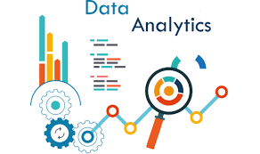
Data Analytics in Excel Using XBRL Tags
Christina M. Olear, Pennsylvania State University Brandywine
Veronica Paz, Indiana University of Pennsylvania
Timothy S. Creel, Lipscomb University

Slide 2
Data Analytics in Excel Using XBRL Tags
Christina M. Olear, Pennsylvania State University Brandywine
Veronica Paz, Indiana University of Pennsylvania
Timothy S. Creel, Lipscomb University

Slide 3
Goals of Project :
Technological Agility
SEC/Edgars
XBRL
Data Analytics Software
ETL & Data Visualization
Confidence & Understanding

Slide 4
Flexibility & Tips
AIS or upper-level accounting class
Can be used piecemeal in selected accounting classes (scaffolding effect).
Analyze the trends and patterns for one company, one industry, or several co.’s in an industry
Analyze the data - internal standpoint - demonstrate data analytics & business strategy/goals
TIP – DETAILED step by step directions – videos, screen shots, etc.
TIP – encourage mistakes

Slide 5
Data analytics fundamental
Data structure, rows, columns, fields, tables, datasets.
Date types – numeric, alphanumeric, dates and times
Structured vs. Unstructured
Wide or Long data
Data Dictionary
FACT
Frame the question
Assemble the data
Calculate results
Tell others

Slide 6
Navigate Edgar’s
Subtitle
Subtitle
Add text, images, art, and videos.
Add transitions, animations, and motion.
Save to OneDrive, to get to your presentations from your computer, tablet, or phone.
Open the Design Ideas pane for instant slide makeovers.
When we have design ideas, we’ll show them to you right there.

Slide 7
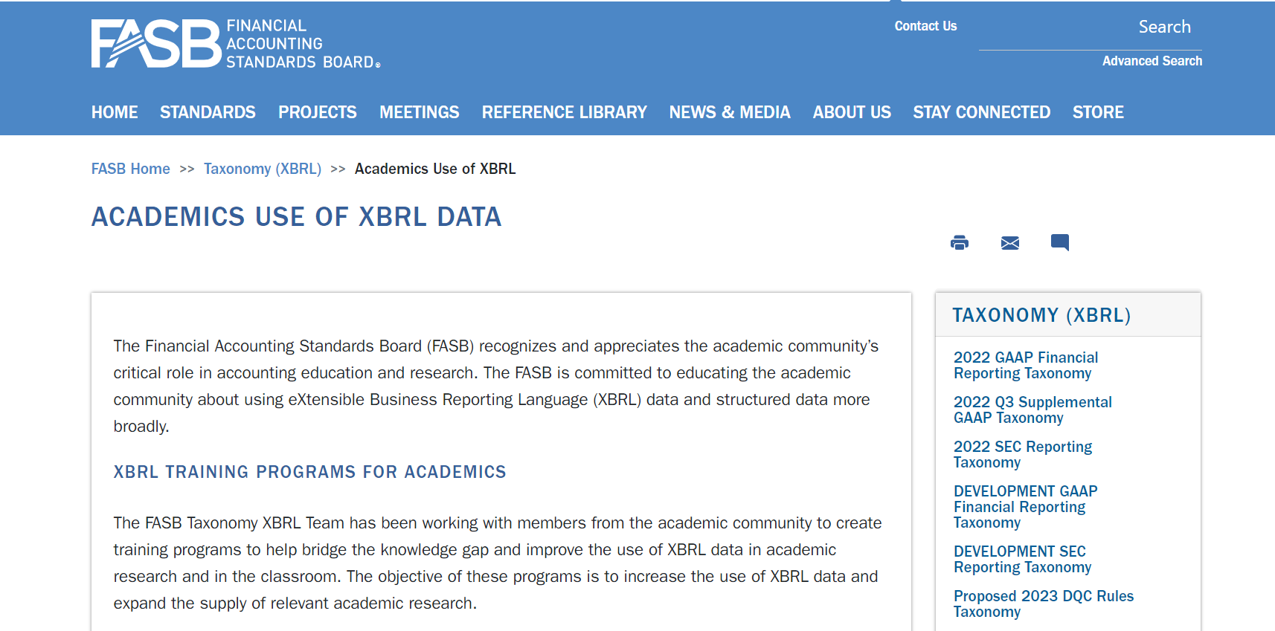
Training sources

Slide 8
XBRL
They learn to use XBRL data after learning about taxonomy, tags, datasets, fields, and field types

Slide 9
FASB training sources

Slide 10
XBRL in Edgar’s

Slide 11
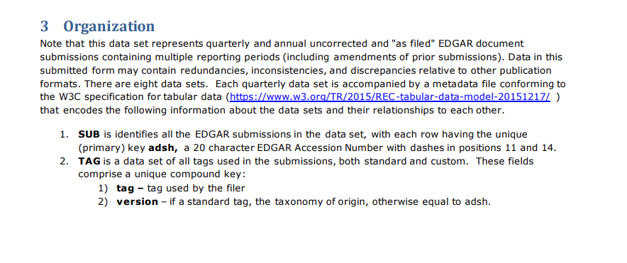
XBRL in Edgar’s

Slide 12
XBRL in Edgar’s

Slide 13
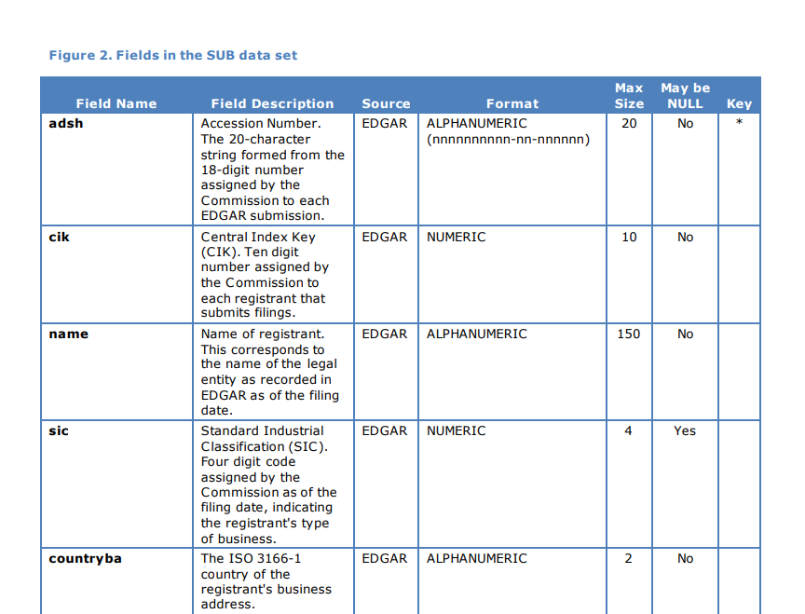
XBRL in Edgar’s

Slide 14
ETL – 1st step in data analytics
Extract – find the data
Transform – get the data ready for analysis – clean it and bring in multiple sources of data
Load – load data in software – Tableau or Power BI
Students learn why this is a crucial step in data analytics. They enjoy mastery of this skill.

Slide 15
Excel fundamentals
Basics – column, row, data type, data dictionary
Sort data
VLOOKUP functions
Pivot tables – create and apply filters
Create calculations columns in pivot tables – average, sum, etc.
Slice and Dice – sort the pivot table
Create a pivot chart

Slide 16
Combining Data In Excel
Join – matching 2 datasets by the values in one or more columns. (add more columns)
Stack or union – Essentially adding more rows. Columns have to be the same name and type
Can pull data from different files (10K) and then Join them. Left Join (easy in Excel using VLOOKUP’s)

Slide 17
Combining Data In Excel (continued)
VLOOKUP’s are powerful but….
The index file has to be in 1st column of the table
Table has to be ordered by the lookup value.
Index and match functions – more complicated than VLOOKUP but can save time in the long run (because you don’t have to create more tables).
Joins – issue with row name changes (net income vs net loss)
Stacking – simple (copying and pasting files) but the problem is there could be format issues. Works well if long data sets are broken down into several different files.

Slide 18
Data Visualization – Exploratory & Presentation
What are the key insights, patterns, trends?
How can I best present the insights to others?
Discuss different charts to use based on audience
Scatter plots, bar charts, pie charts, histograms, line charts, etc.
Discuss visualization perception basics – highlight what you want to focus on, ensure visualization isn’t too “busy”
best practices – best color schemes for accessibility.

Slide 19
Tech considerations
Excel – familiar to students (limitations)
Power BI – ETL, less intuitive than Tableau, not Apple product friendly
Tableau Prep – ETL – but could be an issue for underpowered computers
Alteryx – ETL – more features than Excel for ETL
Tableau – ETL and visualization – Apple product friendly & more intuitive interface than Power BI
Google Sheets – works with Chromebooks

Slide 20
Potential issues:
Student will have different levels of technological agility and experience.
It’s an advanced project and students can be intimidated due to lack of experience (or confidence) with their data analytics, technology, and/or statistics skills.
There may be a few errors in the XBRL files on the Edgar’s website, which could result in potentially inaccurate findings. 34% of Form 10-K and Form 10-Q filings include errors (XBRL US data quality committee).
Tech issues with software for students depending on their device and operating system. It’s optimal to work on the project in a computer lab, although there can be issues with lab installation of software, licenses, university approvals, etc. The disadvantage is student may have difficulty accessing the lab to work on the project outside of class.

Slide 21
The way to get started is to quit talking and begin doing.
Walt Disney

