Slide 1
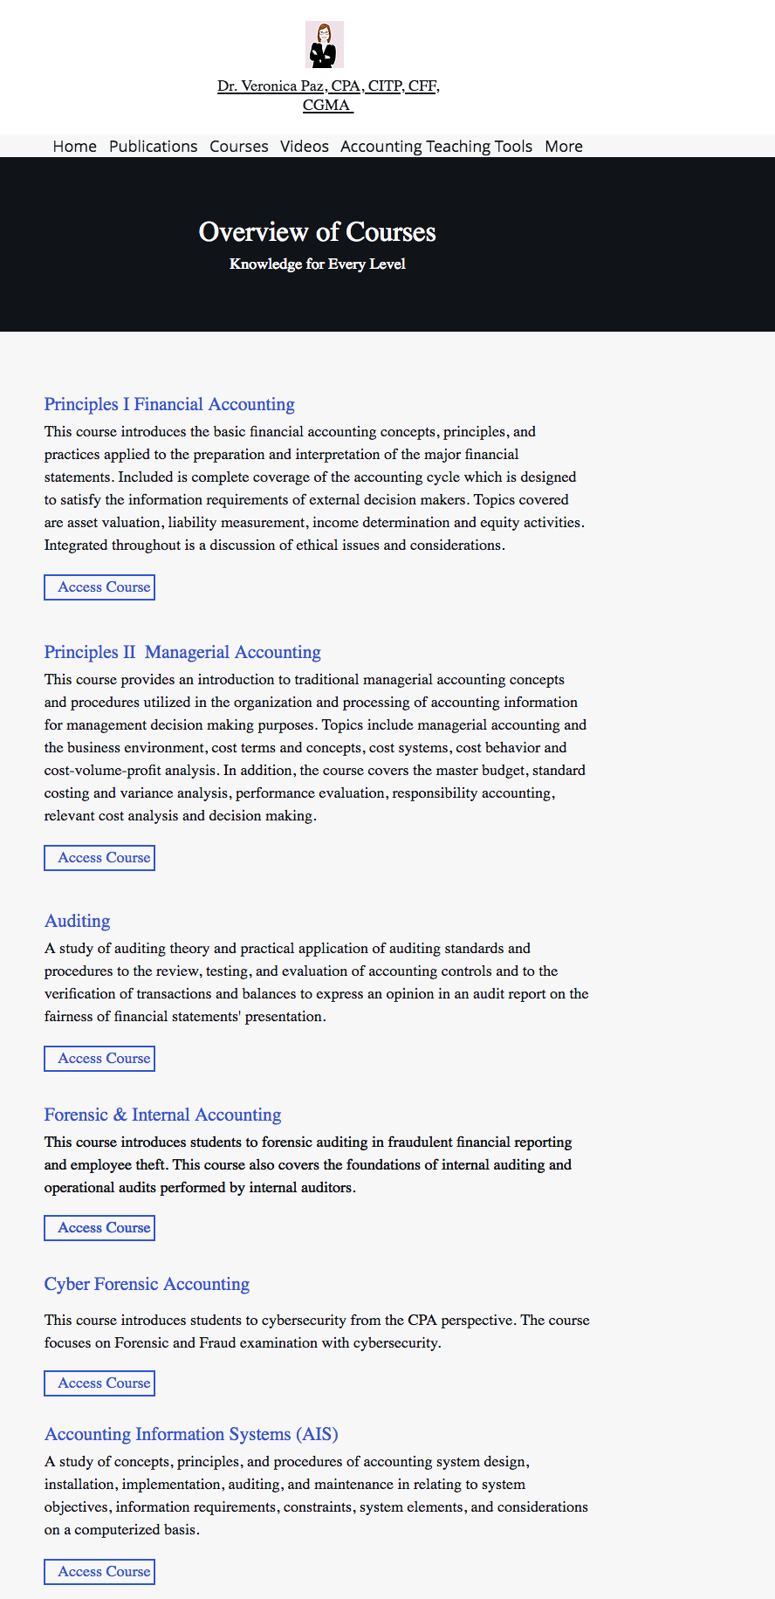
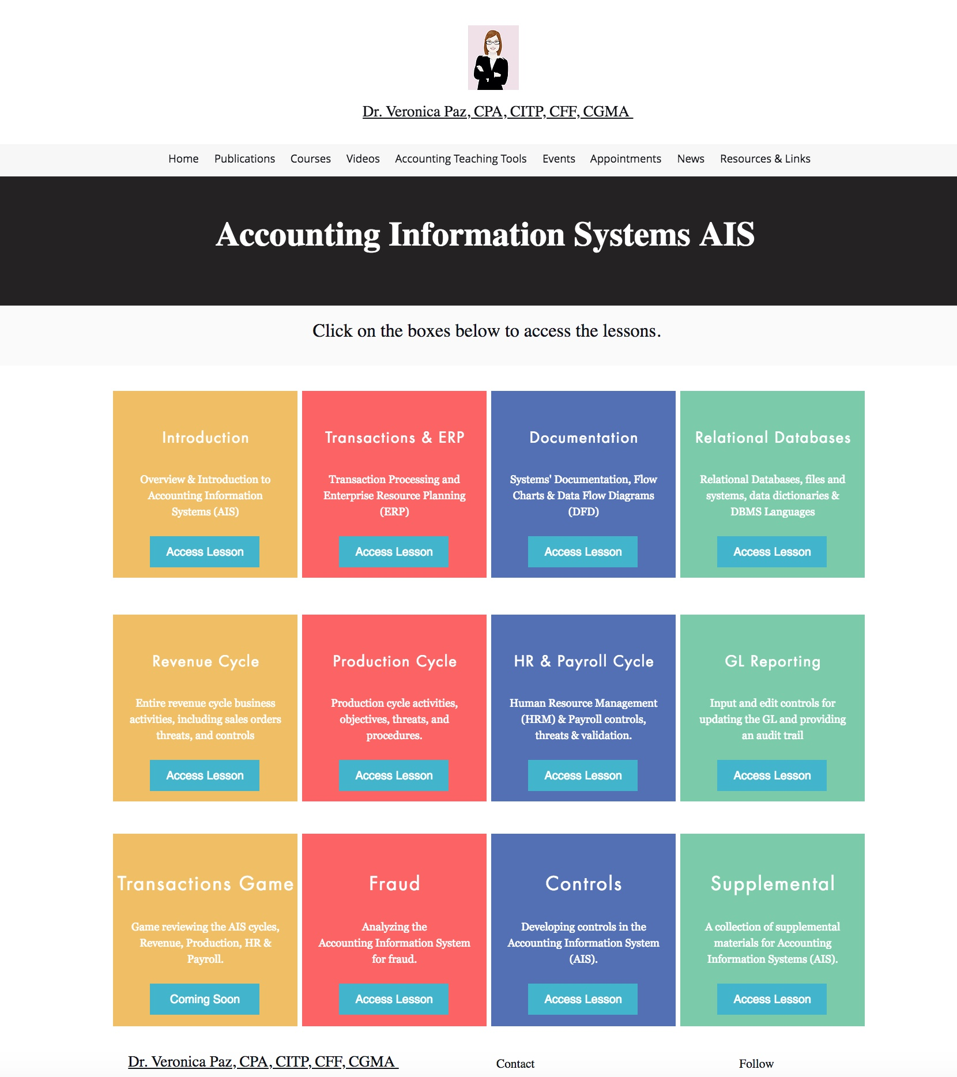
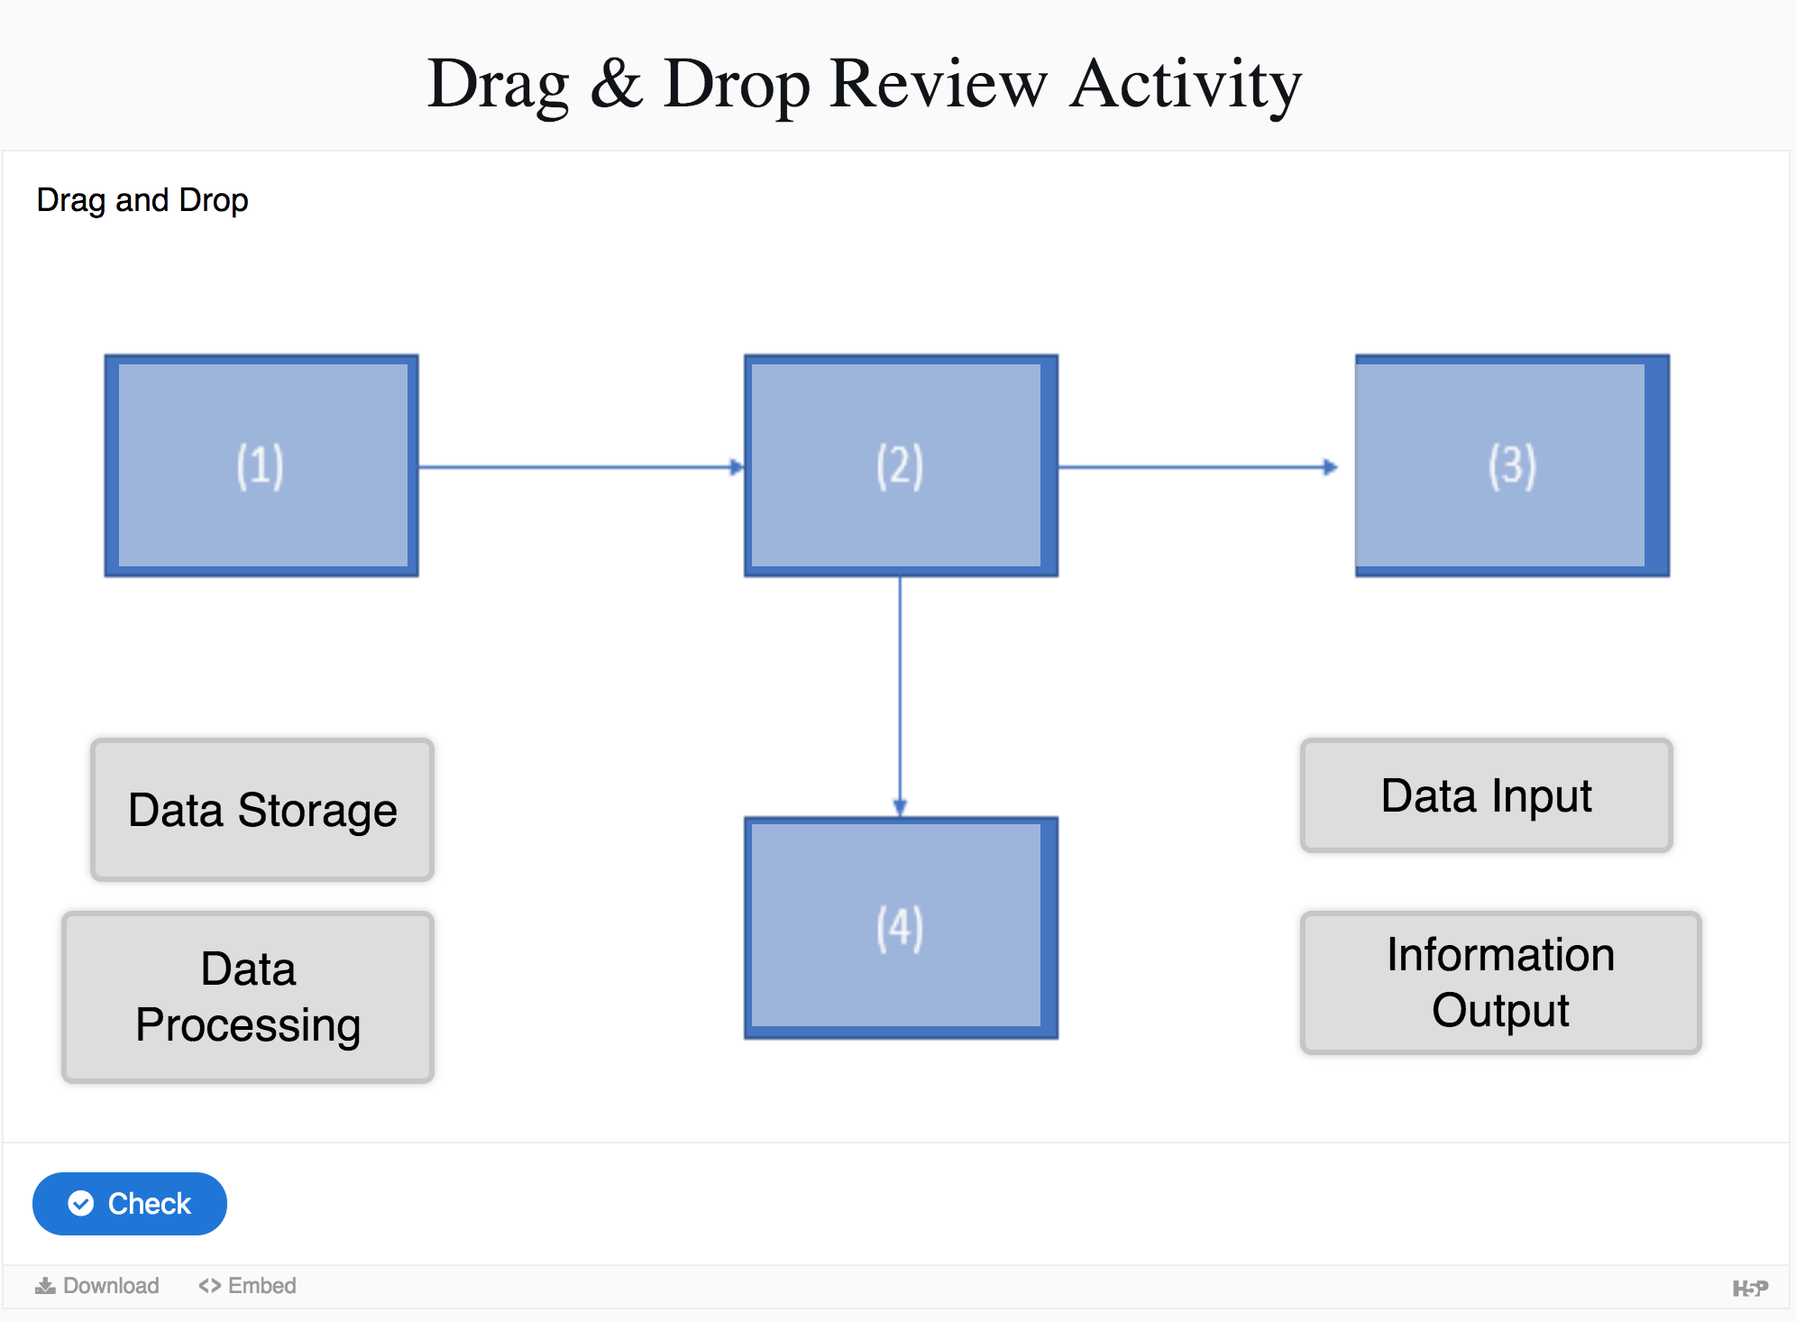
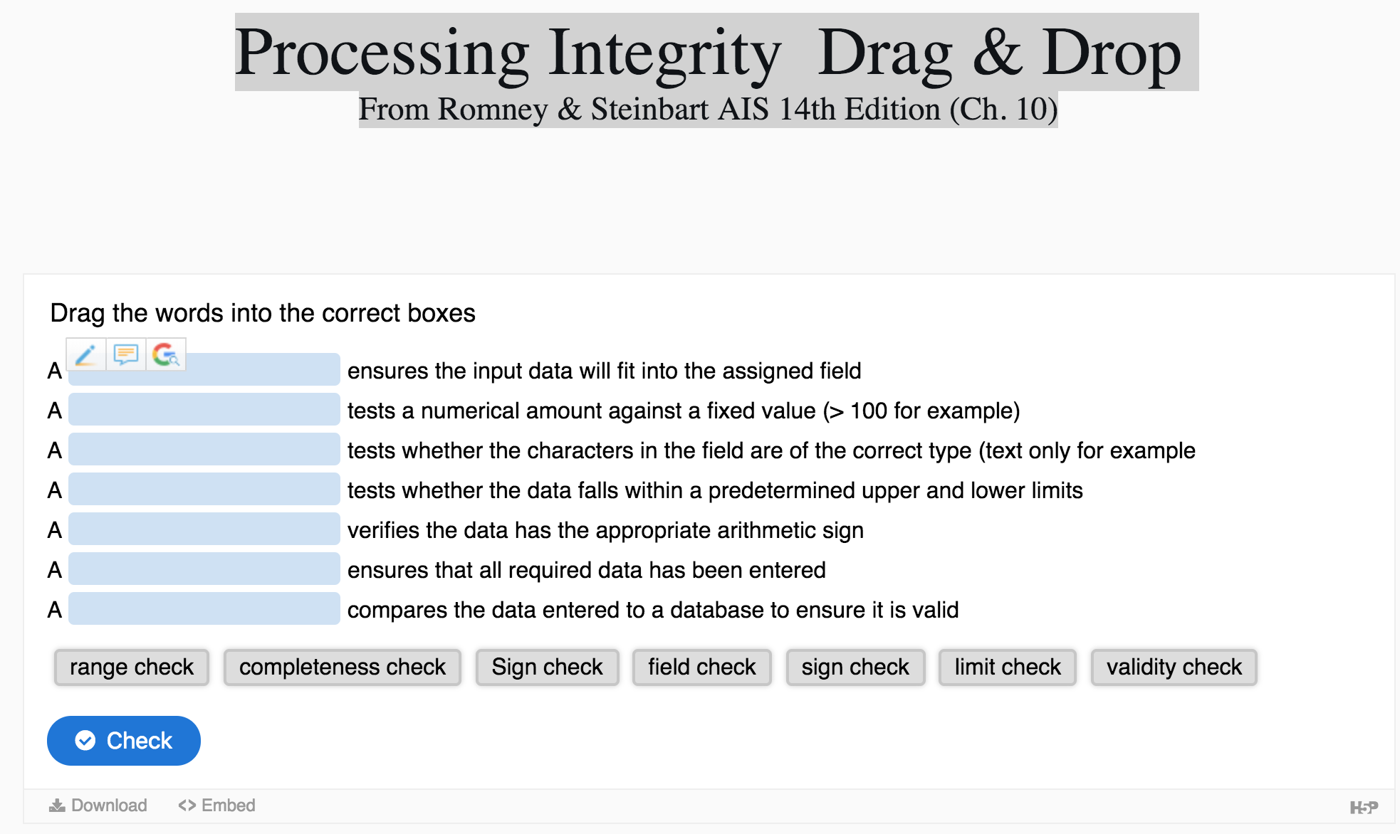
Enthusiastically using H5P for Interactivity in the Classroom
Veronica Paz and Amy Igou
Indiana University of Pennsylvania and University of Northern Iowa
Dr. Paz
Dr. Igou
ABOUT H5P
H5P ELEMENTS & ACCOUNTING COURSES
ACCESS OUR CONTENT
H5P (www.H5P.org) is a free and open source content collaboration platform. H5P is an abbreviation of HTML 5 Package. H5P allows via JavaScript you to create share, and reuse your content.
That is exactly what we did. We created several different elements. We share them in our webpage www.AccountingTeachingTools.com.
Anyone can embed any H5P content element we create,
Drag and drop
Multiple Choice Questions
Interactive Course Presentations
Image Hotspots
Dialog Cards
Flash Cards
Drag the words
Fill in the Blank and
More
We provide all content we create by course and lesson.
Locating Content
First, visit our webpage www.AccountingTeachingTools.com. Then visit our Course Page https://www.drvpaz.com/courses. This page (see figure below) lists a brief description of each course that we have content for currently. This page is expanding regularly. Once you access a course, you will see the course landing page, which details the lessons.
Lessons
Once you locate the course you want, lets assume that is Accounting Information Systems (AIS) https://www.drvpaz.com/ais-course. See figure below for image of the course landing page. Then you will see boxes with buttons to access the lessons. Once you locate the lessons, you will see the H5P elements created.
H5P Elements
Below are a few samples of the H5P elements that you can download or embed in your course. We also have a video at www.AccountingTeachingTools.com to show you how easy it is to embed.
Course Presentation H5P Element for an Introduction to AIS lesson.
Drag and Drop Review Activity for ERP Transactions in an AIS lesson.
Dialog Cards H5P Element in the HR & Payroll Cycle AIS lesson.
Drag the words H5P Element in an AIS course.
Access Our H5P Elements
All of the content we create for any course, we share via our website, www.AccountingTeachingTools.com.
We share via a Creative Commons license
You are free to download and modify the content we create.
You may also choose to simply embed the current H5P element and place it in your LMS.
We have videos showing you how to embed in D2L Brightspace and Blackboard. The other LMS are very similar.
All authors create content regularly and share anything they create via the courses and lessons. Visit often to see new content.
The website also has a form for you to share you content with us!
www.AccountingTeachingTools.com
HOW WE USE
Visit our webpage
www.AccountingTeachingTools.com
We share all of the H5P content we create via a creative commons license. The website also provides a video to show you how easy it is to access and reuse our content
We embed all of our H5P elements in our LMS. We have videos on our website, www.AccountingTeachingTools.com showing how to embed our content into D2L and Blackboard. This can be accomplished via a few steps.
We incorporate our content first into our Accounting Information Systems (AIS) course. Both authors teach AIS and have shared all H5P elements in our webpage. Veronica also teaches Auditing and Forensic Accounting where she has incorporated H5P.
We have used various H5P elements in the following ways.
Auditing: For the opinions we use image and multiple image hotspots to identify the different paragraphs.
Most Accounting Courses: The most commonly used H5P element is the Course Presentation. The authors prepare their own slides in H5P and add activities such as
Multiple choice ”Check Your Understanding” questions
Dialog cards which require the student to turn the card over to reveal the answer
AIS: We use Drag and Drop activities for business processes.
Financial Accounting: The authors created a glossary of flash cards for terminology review.
1. Course Presentation H5P accessible at
https://www.drvpaz.com/ais-introduction
3. Dialog Cards H5P accessible at
https://www.drvpaz.com/hr-payroll-cycle
Courses Page
AIS Course Landing Page
2. Drag & Drop H5P Element accessible at https://www.drvpaz.com/transactions-erp
4. Drag the Words H5P Element accessible at
https://www.drvpaz.com/ais-supplemental-resources.

