Slide 1
Flipgrid: Videos for Online Courses
Tim Creel, Lipscomb University
Veronica Paz, Indiana University of Pennsylvania
Chris Olear, Penn State University

Slide 2
Flipgrid
Flipgrid allows students to post video responses and respond to the posts of other students or the professor.
It adds a personal feel to online courses and helps students learn video presentation skills
This Photo by Unknown Author is licensed under CC BY

Slide 3
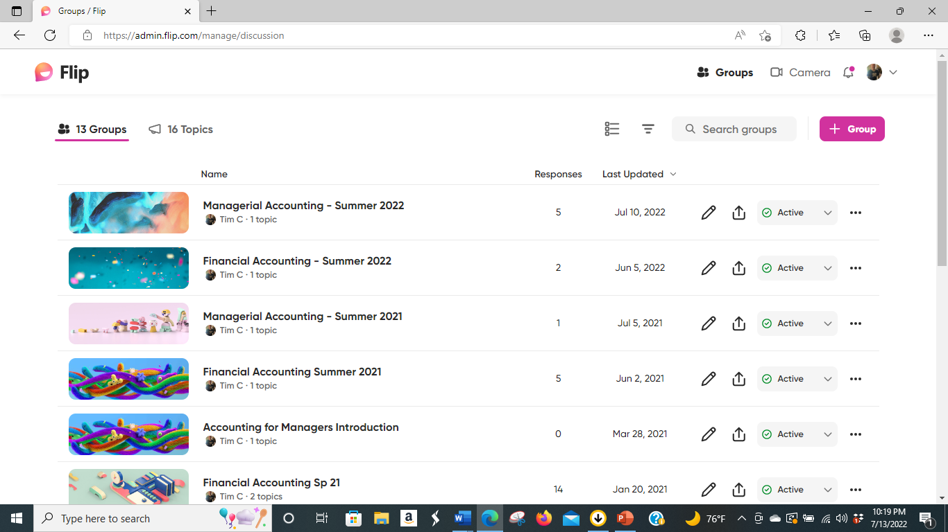
Getting Started with Flipgrid
Students and faculty may set up a free account at the following address:
Flip is a video discussion and sharing app, free from Microsoft.
The faculty member would set up the group for a class by clicking on the group link in the top right corner

Slide 4
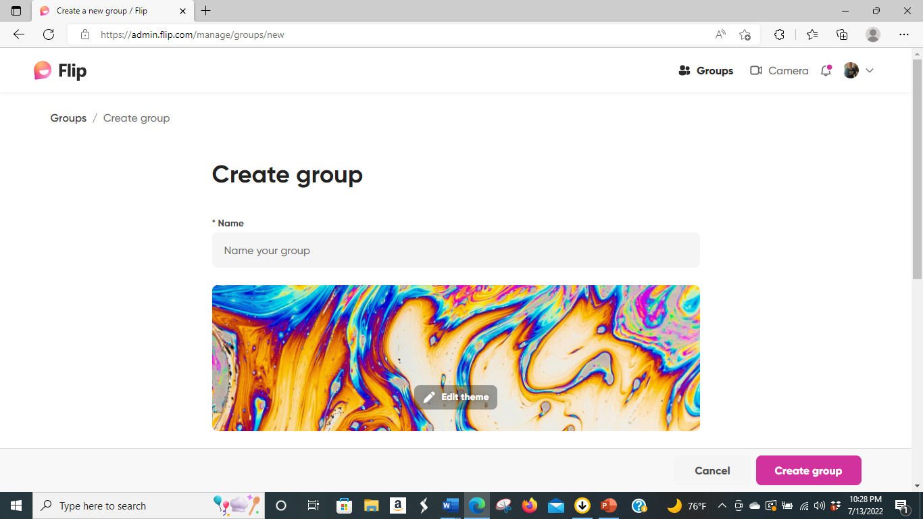
Setting up a Group in Flipgrid
After clicking on the link to create group, the professor will need to name the group and click create group

Slide 5
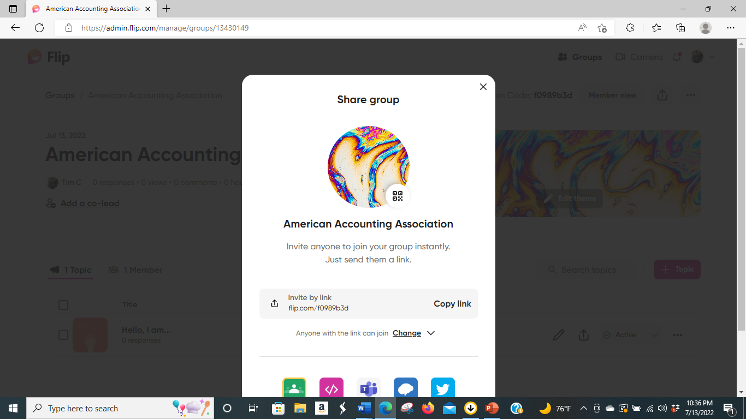
Setting up a Group in Flipgrid
The faculty member would want to invite the class to participate by sharing the link

Slide 6
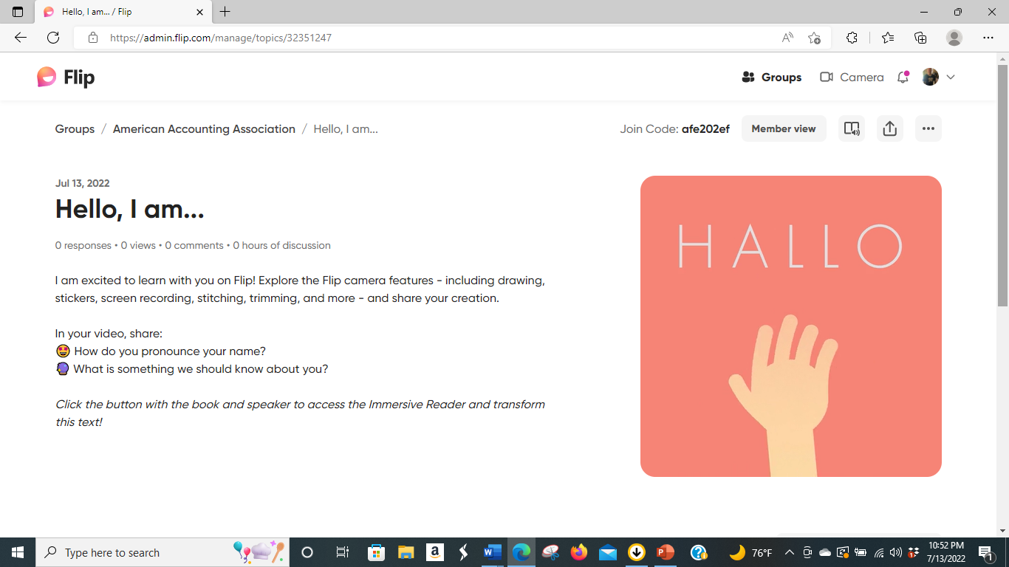
Student Recordings
Students can make a 60 to 90 second video presentations using Flipgrid.

Slide 7
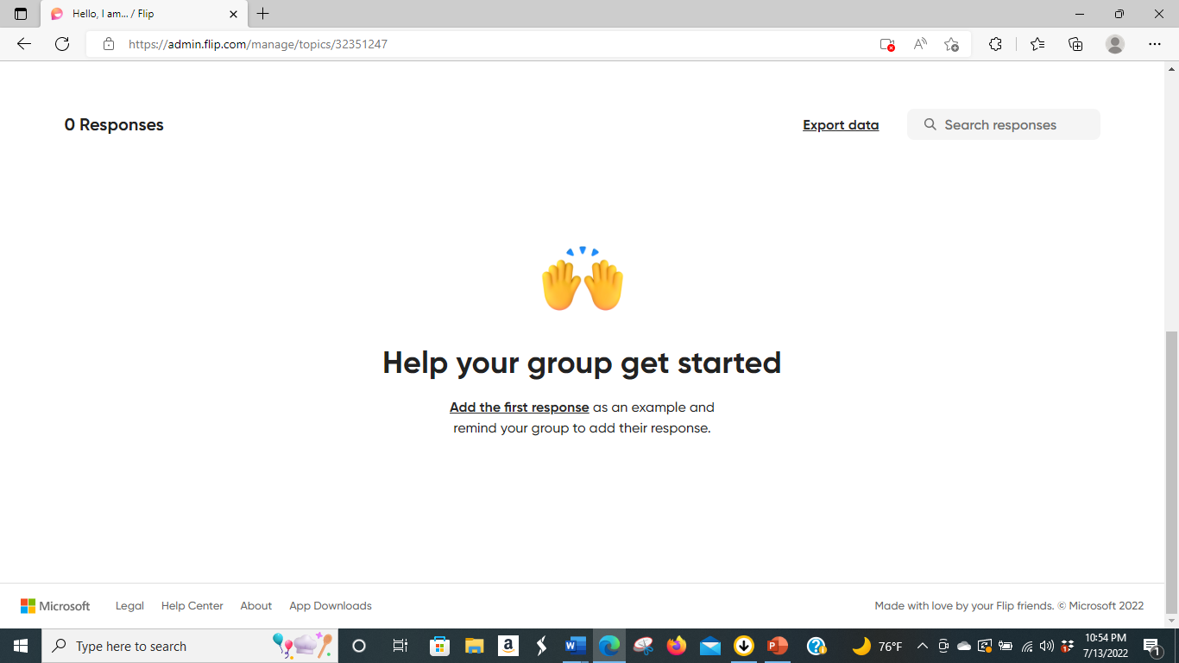
Student Recordings
Faculty may want to make the introductory recording to set the tone for students

Slide 8
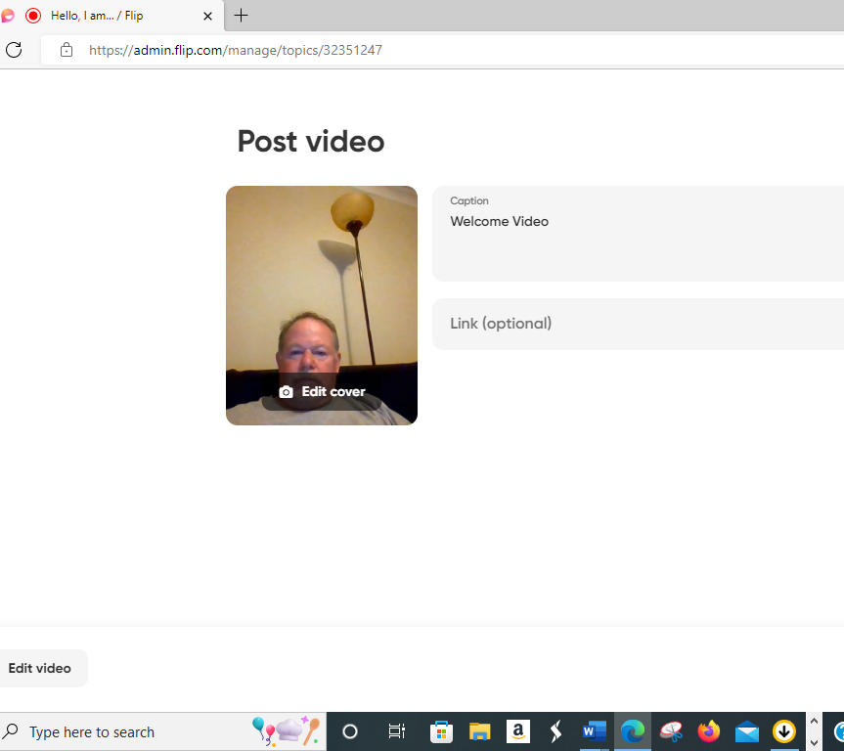
Faculty Video
Faculty would create their video in a similar manner to students. The video can be edited and music added before posting to the topic.

Slide 9
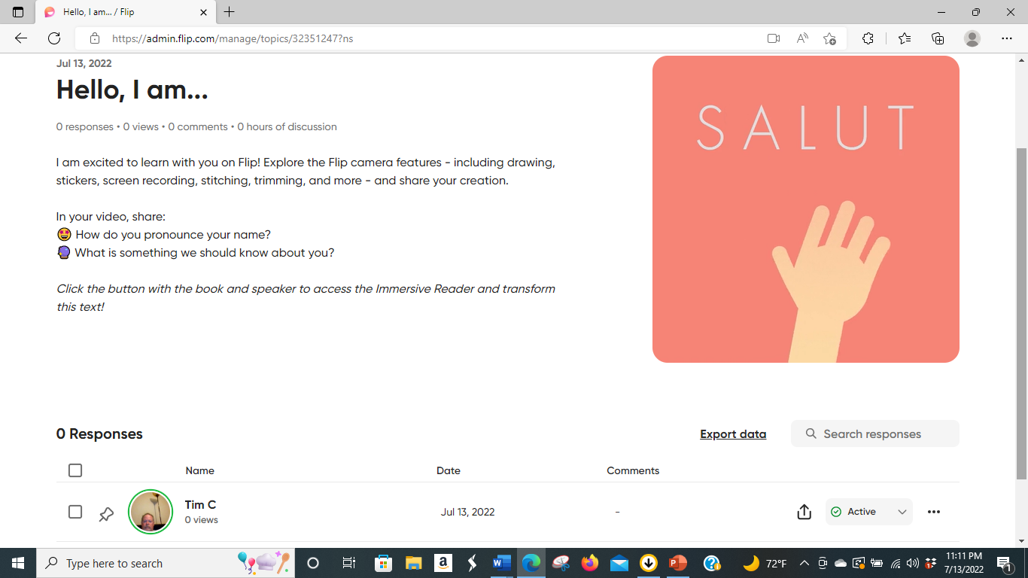
Posting Video to the Topic
The faculty member can then post the video to the topic. Students will follow a similar process to create their own videos.

Slide 10
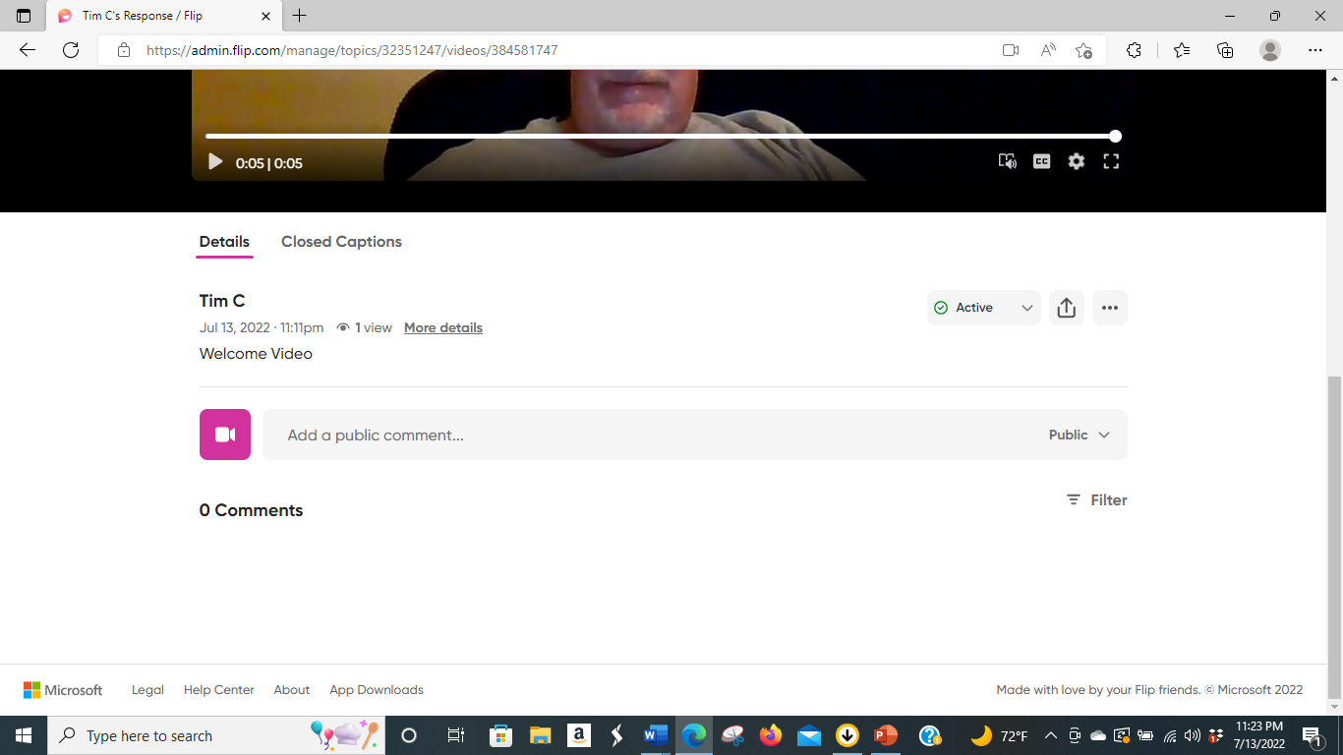
Responses to Other Posts
Faculty members or students can make video response to posts.

Slide 11
Uses in Online Courses
Great for student introductions as students prepare their presentations. Other students and the professor can watch and make response videos.
Adds a more personal touch to online courses as students and the professor can see each other and converse by video.
This Photo by Unknown Author is licensed under CC BY

Slide 12
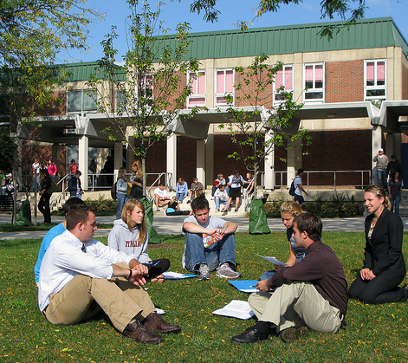
Uses in Online Courses
Flipgrid integrates with Learning Management Systems such as Canvas.
It can also be used for student discussion questions to promote class engagement. The Professor can start the discussion with the video question. Students can respond to the professor and other students through their own video presentations.
This Photo by Unknown Author is licensed under CC BY

